Slide 1


Election Mail for the
State for Connecticut

Slide 2
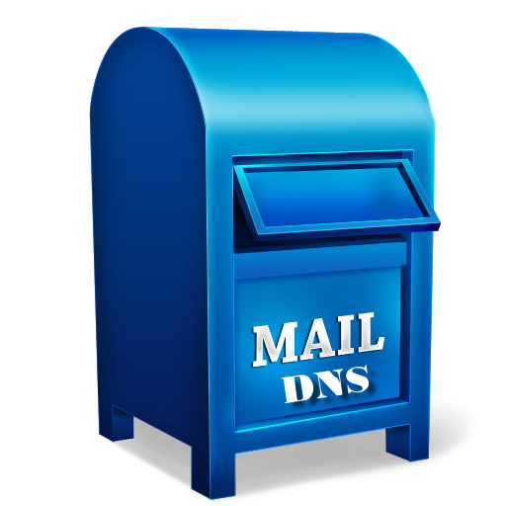

Our standard delivery time for 1st class mail is 2-5 days.
Consider the time your letter will take to get to your voter and be returned back to your office.
Remind your voters to consider the pick-up time of the collection box used.
CHECK THE POSTED PICK UP TIME

Slide 3
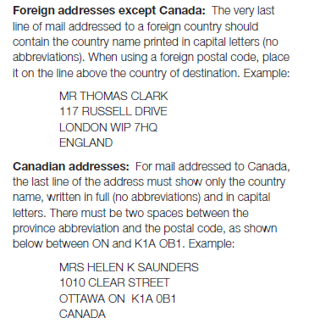
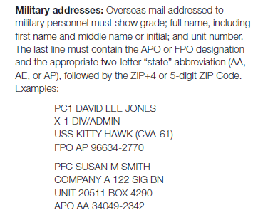
Addressing Official Election Mail to Persons Overseas and in the Military

Slide 4
Addressing Returning Ballots
Recommended: type your address on a label with font size 14 and place neatly in the center of envelope
Not recommended: hastily hand written or rubber stamp
The size of the font of the mailing address must be larger than the return address

Slide 5
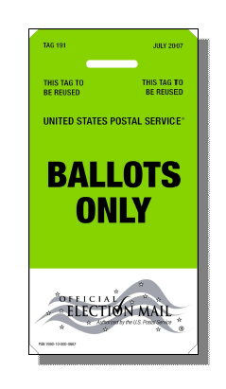
Identifying
Use a postal tray and green tag 191
Rubber band small amounts and use green tag 191 and place in a separate tray

Slide 6

Make a plan with your local Postmaster to retrieve any last minute ballots.

Slide 7
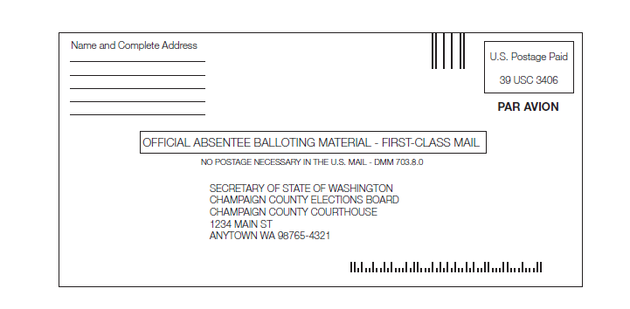
Q&A Follow up from webinar
International Absentee ballots
All outbound international ballots must bear the appropriate US postage
All returning international ballots should have the indicia circled below which will eventually incur a postage due charge to the town clerk’s postage due account.
If a country does not honor the indicia, postage for that country will have to be paid using postage from that country.
Options:
The voter could bring the
ballot to a military base or
a US Embassy.

