Slide 1
Connecticut HUSKY Health:
MQISSP in Context of the Overall Connecticut Medicaid Reform Agenda
Presentation to the SIM Steering Committee
June 9, 2016

Slide 2
Medicaid Quality Improvement and
Shared Savings Program (MQISSP)
Overview

Slide 3
MQISSP . . .
is a Connecticut Medicaid upside-only shared savings initiative whose aim is to build on the successes of the current Medicaid reform agenda and further improve health and satisfaction outcomes for Medicaid beneficiaries who are served by Federally Qualified Health Centers (FQHCs) and “advanced networks”

Slide 4
will use the existing Connecticut Medicaid Person-Centered Medical Home (PCMH) initiative, under which 40% of Medicaid members are being served, as an essential building block to expand upon current practice transformation work
will build on existing supports for members (ASO-based member services and Intensive Care Management, ICM) and providers (primary care rate increase, PCMH payments, EHR payments, ICM)

Slide 5
will use the Department’s current Person-Centered Medical Home attribution model to identify where beneficiaries have sought care, and prospectively assign beneficiaries to MQISSP Participating Entities
will continue to ensure that Medicaid members have the right to seek care from any Medicaid provider, and will give them the option to decline to participate in MQISSP

Slide 6
is expected to launch on January 1, 2017 and to serve between 200,000 and 215,000 Medicaid members
will incorporate new care coordination requirements related to integration of primary care and behavioral health care, development of disability and cultural competence, and linkages to the types of community supports that can assist beneficiaries in utilizing their Medicaid benefits

Slide 7
will further the Department’s interests in preventative health and begin to re-shape the paradigm for care coordination in a direction that will support population health goals for individuals who face the challenges of substance abuse and behavioral health, limited educational attainment, poverty, homelessness, and exposure to neighborhood violence
Will include a package of strategies designed to prevent, detect and remedy under-service

Slide 8
will make supplemental payments to Participating Entities that are Federally Qualified Health Centers (FQHCs) in support of enhanced care coordination activities (e.g. behavioral health integration, cultural competency, disability competency)
will make shared savings payments to all Participating Entities (both FQHCs and “advanced networks”) that achieve benchmarks on a core set of measures of quality and care experience

Slide 9
MQISSP
Enhanced Care Coordination Activities
Use of Medicaid claims data to perform predictive modeling
Administrative Services Organization-Based Intensive Care Management
Upside-Only Shared Savings Arrangements
Person-Centered Medical Home Practice Transformation

Slide 10
MQISSP model design process and source material:
DSS developed MQISSP model design through monthly meetings and work group sessions, as well as subject specific webinars, with the Care Management Committee of the Medical Assistance Program Oversight Council (MAPOC)
All source documents are available on the face page of the MAPOC website at:
https://www.cga.ct.gov/med/

Slide 11
Connecticut Medicaid Reform Context

Slide 12
HUSKY Health at a Glance
Critical source of economic security and well-being to over 750,000 individuals (21% of the population of Connecticut).
Covers an extensive array of preventative services (primary care through Person-Centered Medical Homes, dental and behavioral health coverage) as well as care coordination.
Data driven.
Maintains a fully integrated set of claims data for all covered individuals and all covered services.
Uses data analytics to direct policy-making, program development and operations.
Already doing more with less.
Administrative costs are 5.2%. Total staffing (131 individuals) has held relatively constant while the number of individuals served has dramatically increased.
59% of Connecticut Medicaid and 88% of CHIP (HUSKY B) expenditures are federally reimbursed.
Serves adults, working families, their children, their parents and their loved ones with disabilities.
Health expenditures (70.7% of department budget) are increasing based on caseload growth, but trends in per person costs are stable and quality outcomes have improved.
Successful in improving quality, satisfaction and independence through prevention and integration.
Employs predictive modeling to identify both those in present need of care coordination, and those who will need it in the future.

Slide 13



HUSKY Health touches everyone.
Children. Working families and individuals.
Older adults. People with disabilities.
Your neighbor. Your cousin.
One in five CT citizens is served by HUSKY Health.

Slide 14




HUSKY Health . . .
extends financial security from the catastrophic costs of a serious health condition
enables people to stay well, through prevention, and to work
promotes the health, well-being and school readiness of children
supports independence in the community

Slide 15
HUSKY Health is mission-driven.
DSS works in partnership with stakeholders across the health care delivery system to ensure that eligible people in Connecticut receive the supports and services they need to promote self-sufficiency, improved well-being and positive health outcomes. We ensure that the delivery of these services is consistent with federal and state policies.

Slide 16





HUSKY Health is person-centered.

Slide 17
HUSKY Health is improving outcomes while controlling costs.
Health outcomes and care experience are improving. We are enabling independence and choice for people who need long-term services and supports.
Provider participation has increased.
Enrollment is up, but per member per month costs are stable.
The federal share of HUSKY Health costs has increased.

Slide 18
HUSKY Health has maximized benefits under the Affordable Care Act.
100% federal coverage for expansion of Medicaid eligibility (HUSKY D)
coverage of new preventative services including smoking cessation and family planning
new resources for behavioral health integration
$77 million in funding under the State Balancing Incentive Program for home and community-based long-term services and supports (LTSS)

Slide 19
Conceptual framework
DSS is motivated and guided by the Centers for Medicare and Medicaid Services (CMS) “Triple Aim”:
improving the patient experience of care (including quality and satisfaction)
improving the health of populations
reducing the per capita cost of health care

Slide 20
  We are also influenced by a value-based purchasing orientation. The Centers for Medicare and Medicaid Services (CMS) define value-based purchasing as a method that provides for:
  Linking provider payments to improved performance by health care providers. This form of payment holds health care providers accountable for both the cost and quality of care they provide. It attempts to reduce inappropriate care and to identify and reward the best-performing providers.

Slide 21
Hypotheses
We have two critical reform hypotheses:
Centralizing management of services for all Medicaid beneficiaries in self-insured, managed fee-for-service arrangements with Administrative Services Organizations, as well as use of predictive modeling tools and data to inform and to target beneficiaries in greatest need of assistance, will yield improved health outcomes and beneficiary experience, and will help to control the rate of increase in Medicaid spending.

Slide 22
Building on current preventative and coordinative interventions (e.g. PCMH, ASO-based Intensive Care Management) by migrating such efforts to a more community-based approach and building in appropriate value-based payment strategies (e.g. pay-for-performance, bundled payments, episodes, shared savings arrangements) will yield further improvements in health outcomes and beneficiary experience, and will continue to control the rate of increase in Medicaid spending.

Slide 23
Key Terms
Term | Acronym | Detail
Administrative Services Organization | ASO | DSS has contracted with four organizations (CHN, Beacon, Benecare and Logisticare) to act as statewide ASOs. The ASOs perform many traditional member support functions , but are also responsible for data analytics and ICM.
Behavioral health home | BHH | DMHAS and DSS have partnered to implement this new means of integrating behavioral health, medical care and social service supports for individuals with Serious & Persistent Mental Illness.
Expansion group | HUSKY D | Connecticut’s Medicaid expansion group includes adults at 18-64 who are not otherwise eligible for another Medicaid coverage group.
Fee for Service | FFS | A method in which doctors and other health care providers are paid for each service performed. Examples of services include tests and office visits.
Intensive Care Management | ICM | A set of services that help people with complex health care needs to better understand and manage their care.
Long-term services and supports | LTSS | Long-term services and supports (LTSS) are a spectrum of health and social services that support elders or people with disabilities who need help with daily living tasks.
Medicaid Quality Improvement and Shared Savings Program | MQISSP | MQISSP is a Connecticut Medicaid initiative under which DSS will enter into shared savings arrangements with FQHCs and advanced networks.
Pay-for-performance | P4P | P4P rewards health care providers for attaining targeted service goals, like meeting health care quality or efficiency standards.
Person-Centered Medical Home | PCMH | PCMH is a model for the organization of primary care that ensures effective delivery of the core functions of primary health care.
Value-Based Payment | VBP | VBP links provider payments to improved performance on quality measures.

Slide 24
HUSKY Health: Past, Present and Future
At A Glance

Slide 25



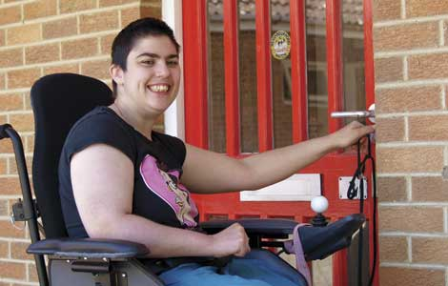

Past, Present and Future
 | Past | Present | Future
Administrative/ financial model | A mix of risk-based managed care contracts and central oversight | Self-insured, managed fee-for service model; contracts with four Administrative Services Organizations (ASOs) | Self-insured, managed fee-for-service model that incorporates health neighborhoods and Value-Based Payment (VBP) approaches
Financial trends | Double digit year-over-year increases were typical | Overall expenditures are increasing proportionate to enrollment; per member per month spending is trending down | Quality-premised VBP strategies will enable further progress on trends
Data | Limited encounter data from managed care organizations | Fully integrated set of claims data; program employs data analytics to risk stratify and to make policy decisions | Data match across human services and corrections data sets will enable more intelligent policy making

Slide 26
 | Past | Present | Future
Member experience | Members had different experiences depending on which MCO oversaw their services; MCOs relied upon traditional chronic disease management strategies | ASOs provide streamlined, statewide access points and Intensive Care Management; PCMH practices enable coordination of primary and specialty care; health homes enable integration of medical, behavioral health and social services | Health neighborhoods will address both health needs and social determinants of health (e.g. housing stability)
Provider experience | Provider experience varied across MCOs; payment was often slow or incomplete | ASOs provide uniform, statewide utilization management and ICM; providers can bill on a bi-weekly basis | Consideration of migration to health neighborhood self-management of provider relationships

Slide 27
Context Setting: The Past

Slide 28
HUSKY Health prior to 2012
Families and children were served under capitated managed care arrangements
Other than those served by waivers, older adults and people with disabilities did not have care coordination
In many areas there was relatively poor access to providers
Beneficiaries and providers experienced many challenges in working with the MCOs
Double digit year-over-year cost increases were typical
DSS had inadequate data on which to base policy decisions or risk stratify

Slide 29
Context Setting: The Present

Slide 30
HUSKY Health 2012 to present
 | Families & Children | Older Adults and People with Disabilities | Eligible Individuals
Current census | 459,839 | 93,731 | 196,436
Administrative structure | Self-insured managed FFS; contracts with ASOs | Self-insured managed FFS contracts with ASOs | Self-insured managed FFS; contracts with ASOs
Interventions | Risk stratification using CareAnalyzer; ASO-based member supports and ICM; dental outreach; PCMH; BHH, MQISSP | Governor’s LTSS rebalancing plan, ASO-based member supports and ICM; PCMH, BHH | Launch of expansion group (HUSKY D), risk stratification using CareAnalyzer; ASO-based member supports and ICM; PCMH, BHH, MQISSP
Results | Improved HEDIS and care experience results, stable PMPM | Improved HEDIS and care experience results, stable PMPM | Improved HEDIS and care experience results, downward trending PMPM

Slide 31
Providers now have the benefit of:
A streamlined electronic provider enrollment process
Standard, statewide utilization requirements and rate schedules for HUSKY Health-covered services
Support with patients with complex needs through ICM
PCMH practice supports, enhanced fees and performance/improvement payments
A claims process through which providers can bill every two weeks and receive full payment on all clean claims
What is the result?
A significant increase in participation of both primary care providers and specialists

Slide 32
PMPM Trends
PMPM for HUSKY D is trending down over time; PMPM for HUSKY A & C has been stable over time.
Department of Social Services
32
Notes:
4/28/2017
32

Slide 33
Comparison with National Trends
* Expenditures are net of drug rebates and include DMHAS' behavioral health costs claimable under Medicaid. This depiction includes all hospital supplemental and retro payments.
Department of Social Services
33
Notes:
4/28/2017
33

Slide 34
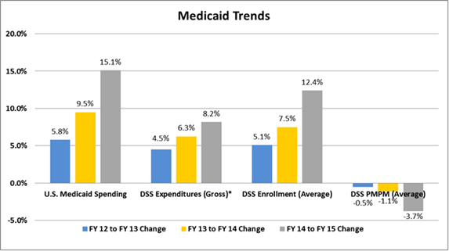
* Expenditures are net of drug rebates and include DMHAS' behavioral health costs claimable under Medicaid. This depiction excludes all hospital supplemental and retro payments.
Department of Social Services
34
Notes:
4/28/2017
34

Slide 35
The Future State

Slide 36

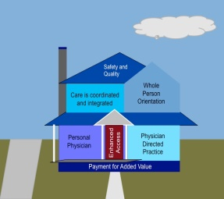






HUSKY Health 2017 and ongoing
Health neighborhoods composed of PCMH practices, specialties, CHWs and non-medical services and supports

Slide 37
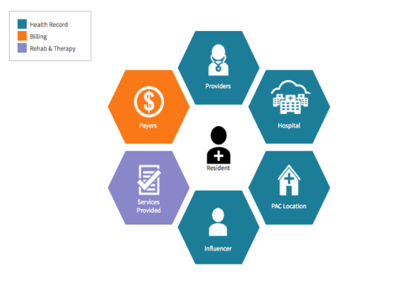

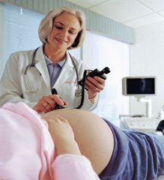
Development of additional value-based payment strategies
MQISSP
PCMH enhanced fees and performance payments
OB P4P
Shared savings arrangements
Episodes of care

Slide 38
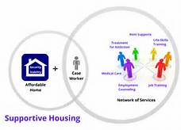
Achievement of a person-centered, integrative, rebalanced system of long-term services and supports
PHR System
BIP System
Personal Health Record
Pre-Screen
Service Provider
BIP System
Transportation
Assessment
Balancing Incentive Program
Person Centered View
MMIS System
Service Provider
LTSS
Services
Claims
Care Plan(s)
Financial
Eligibility
Case Management
BIP System

Slide 39
MQISSP Operational Update

Slide 40
REFORM PAYMENT & INSURANCE DESIGN | Pre-implementation | Perf. Year 1 (Beg. 10/1/16)
Initiatives & Work Steps | May- Sept. 2016 | Q1 (Oct-Dec) | Q2 (Jan-Mar) | Q3 (Apr-Jun) | Q4 (Jul-Sep)
MQISSP
Develop SSP for Medicaid, and engage stakeholders
Finalize Wave 1 RFP for Advanced Network and FQHC entry
Execute Wave 1 provider contracts
Go live with Wave 1, targeting 200,000-215,000 beneficiaries
Commence on-going TTA to providers
Receive, clean, and validate data related to the target population (all sources). Develop expenditure benchmark with calculation. Link quality score and shared saving loss percentages.
Commence under-service monitoring
Prepare baseline reports for comparison of utilization changes occurring after the implementation of the SIM program for Medicaid beneficiaries
10/31
6/6
10/31
1/1
1/31
6/6
4/30
1/31

Slide 41
MQISSP Operational Update
All MQISSP activities are on track for timely completion:
In consultation with the Care Management Committee of the MAPOC, DSS has developed all major aspects of MQISSP model design, including, but not limited to: provider qualifications, care coordination standards, quality measures, shared savings methodology, and a range of strategies designed to prevent, as well as to identify and remedy, under-service to Medicaid members
DSS’ Request for Proposals for MQISSP Participating Entities is slated to be released timely on June 6, 2016

Slide 42
DSS is in active dialogue with CMS on Medicaid authority needed to make supplemental payments (to FQHCs) and shared savings payments to eligible FQHCs and “advanced networks”
Next steps will focus upon further development of the package of strategies around under-service, as well as development of a multi-media communications package on MQISSP for Medicaid members and providers

Slide 43
Accountability Targets:
89% of Medicaid beneficiaries receive their care from MQISSP-participating healthcare entities by 2020:
2017 (Wave 1): 200,000 – 215,000 beneficiaries – after Wave 1 DSS will evaluate outcomes and consider additional wave of participation
2018 (Wave 2): additional 200,000 – 215,000 beneficiaries

