Slide 1
DPH Facility Licensing & Investigation Section
Adverse Events Report Tracking System
Connecticut Department of Public Health
April 20, 2017

Slide 2
Adverse Events Report Tracking System Overview
Facility will submit and track the events in the web based application system:
  Become a Registered User approved by the facility.
  Enter Adverse Events.
  Manage Adverse Events and track them in the Web Application.

Slide 3
Adverse Events Report Tracking System Overview, continued
CT DPH FLIS has overall administrative authority of the application:
  Assists Facilities with user accounts.
  Manages permissions based on user type.
  Application hosted at CT Bureau of Enterprise Systems & Technology (BEST) behind firewalls.

Slide 4
User Role
  Facility Users
    Facility User will be able to login and submit the events to their respective facility.
    A Facility can have more than one registered user.
    A Facility user will be able to see only their approved facility events.
Notes:
Provider Users: may also include Finance (payment reconciliation) staff

Slide 5
Web Application
Step 1: Become a Registered User for a facility
Step 2: Submit Adverse Events
Step 3: Track the Events
Step4 : Communicate with DPH FLIS to follow up with an event in case additional details are requested.
Notes:
Five Steps to Add an Applicant

Slide 6
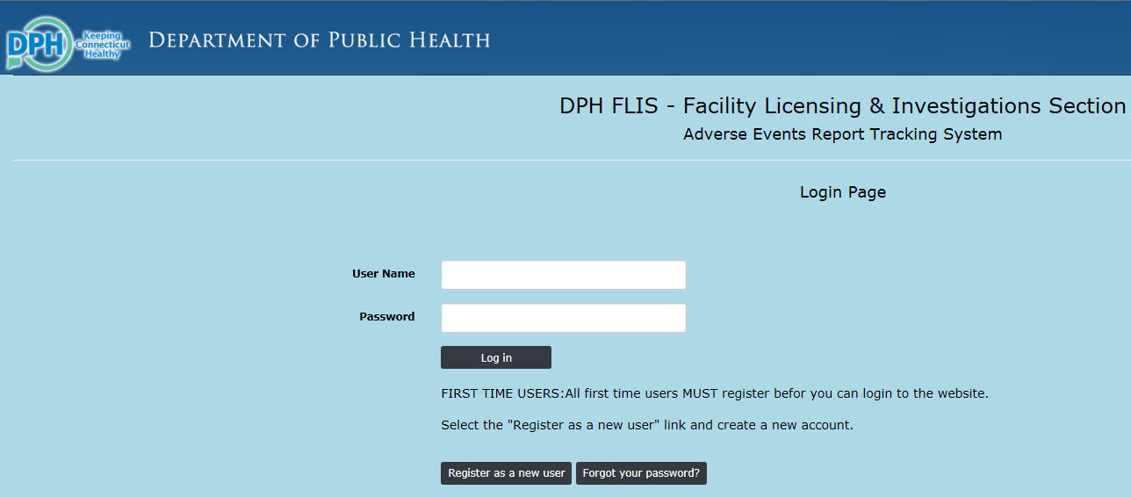
Registering as a New User
Applicant needs to complete:
Consent Form
Fingerprinting Information Form
1. Click the “Register as a new user” button from the adverse events login page
Notes:
Before adding an applicant, need to print the blank Consent Form and Fingerprinting Information Form and give them to the applicant to be filled out.
Certain particulars need to be obtained. That’s why they’re required. This information is from the Fingerprinting Information Form.

Slide 7
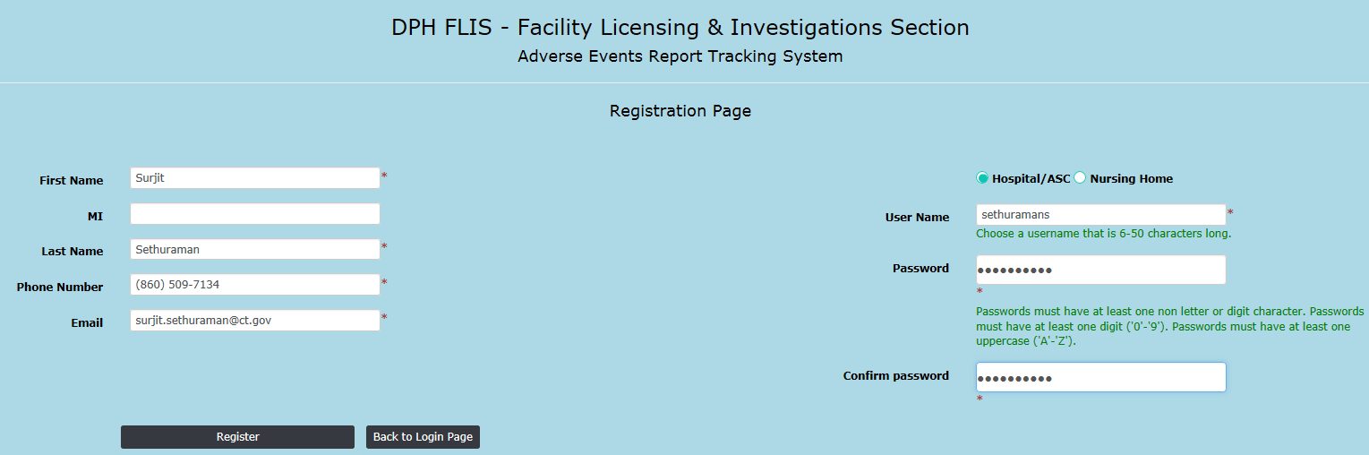
Registering as a New User
Applicant needs to complete:
Consent Form
Fingerprinting Information Form
Fill out all the personal information along with Facility type and name
Click “Register” button.
Notes:
Before adding an applicant, need to print the blank Consent Form and Fingerprinting Information Form and give them to the applicant to be filled out.
Certain particulars need to be obtained. That’s why they’re required. This information is from the Fingerprinting Information Form.

Slide 8
Registering as a New User
Applicant needs to complete:
Consent Form
Fingerprinting Information Form
DPH-FLIS Administrator will check if you are an authorized user and activate your account.
Once account is activated you will receive an automated email that your Adverse Events Report Tracking System account has been activated.
Once your account has been activated, you will be able to login to Adverse Events web application with your username and password
Notes:
Before adding an applicant, need to print the blank Consent Form and Fingerprinting Information Form and give them to the applicant to be filled out.
Certain particulars need to be obtained. That’s why they’re required. This information is from the Fingerprinting Information Form.

Slide 9
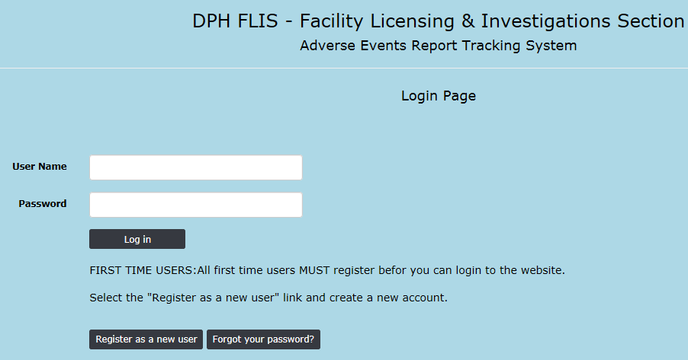
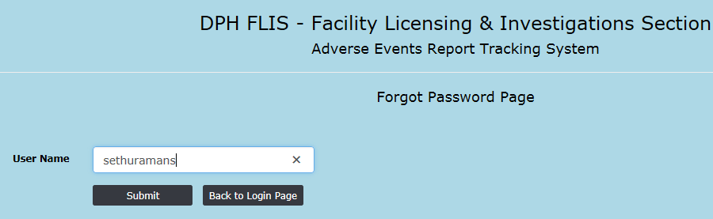
Forgot/Reset Password
Click the “Forgot your password” link from the login Page
Enter your User Name and click the “Submit” button.
An Automated email will be send to the associated email account with a reset password link.
Applicant needs to complete:
Consent Form
Fingerprinting Information Form
Notes:
Before adding an applicant, need to print the blank Consent Form and Fingerprinting Information Form and give them to the applicant to be filled out.
Certain particulars need to be obtained. That’s why they’re required. This information is from the Fingerprinting Information Form.

Slide 10
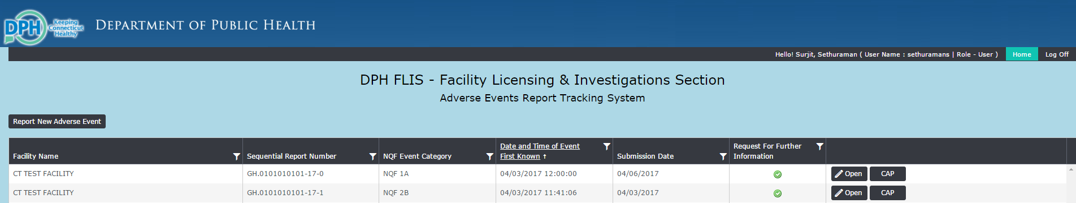
Adverse Events Home/Main Page
Applicant needs to complete:
Consent Form
Fingerprinting Information Form
Once logged in you will see the main/home page which will have all the submitted adverse events from your facility.
A user will be able to see only their facility adverse events that are authorized for them.
Notes:
Before adding an applicant, need to print the blank Consent Form and Fingerprinting Information Form and give them to the applicant to be filled out.
Certain particulars need to be obtained. That’s why they’re required. This information is from the Fingerprinting Information Form.

Slide 11
Report New Adverse Events

Slide 12
Report New Adverse Events
Applicant needs to complete:
Consent Form
Fingerprinting Information Form
Click “Report New Adverse Event” button from the home page.
Notes:
Before adding an applicant, need to print the blank Consent Form and Fingerprinting Information Form and give them to the applicant to be filled out.
Certain particulars need to be obtained. That’s why they’re required. This information is from the Fingerprinting Information Form.

Slide 13
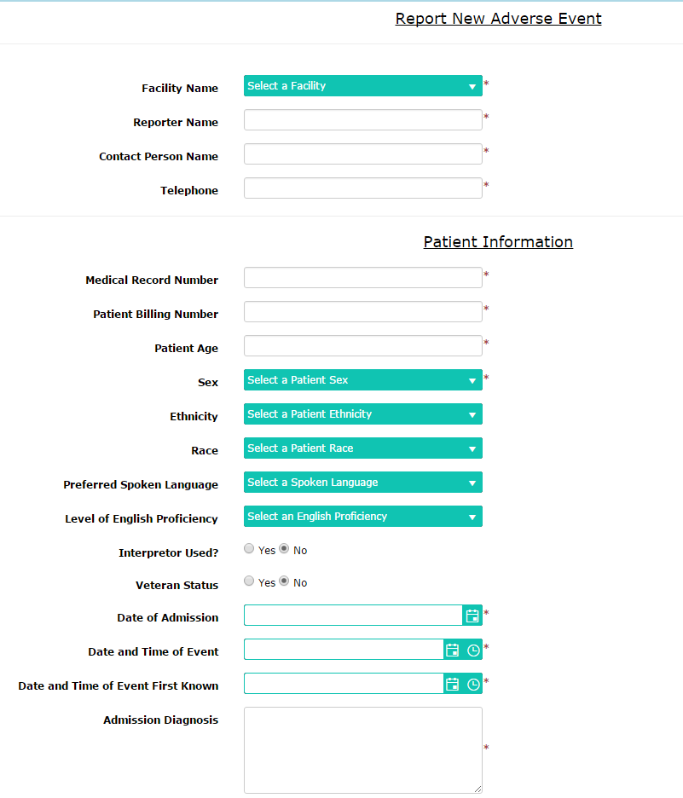
Step 1: Enter Personal and Facility Information
Click the “Add new Event Report” in the Home Page.
Go ahead and fill all the information for the adverse event.
Please scroll down the page to complete the form.
Notes:
To enter a new applicant into ABCMS:
If the applicant does not appear in the search results, click Add New Applicant. The Applicant: Profile screen appears.
In the Personal and Demographic Information section, enter the information for the applicant. Data entered on the previous page cannot be changed.
If the applicant’s Mailing Address is different than their Permanent Address, uncheck the box next to Mailing Address fill out the correct information.
Note: Fields marked with an asterisk are required fields.
4. If the applicant has a previous name (e.g., a maiden name), you must enter this information in the Alias/Prior Name section:
Click Add New in the Alias/Prior Name section. The Alias/Prior Name dialog appears.
Enter the applicant’s alias information, then click Save.
5. If the applicant has lived in a different state, you will need to enter a prior address to allow registries from the other state to be included.
Click Add New in the Prior Addresses section. The Prior Addresses dialog appears.
Enter the applicant’s previous address information, then click Save.
When you are finished adding the applicant’s information, click Next.

Slide 14
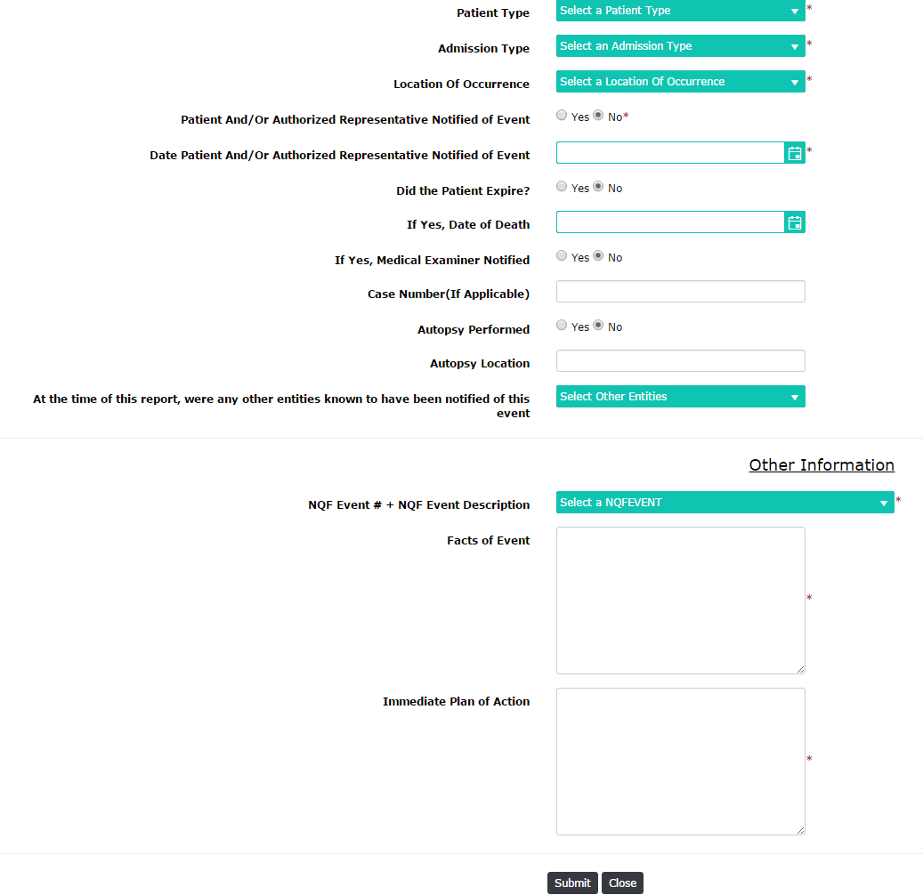
Step 1: Enter Personal and Facility Information
Complete the form and click the Submit button at the bottom of the form.
If you have to cancel the form before submitting it, click the “Cancel” button at the bottom of the form.
Note: You cannot Edit or Delete the Adverse Event once submitted.
Notes:
To enter a new applicant into ABCMS:
If the applicant does not appear in the search results, click Add New Applicant. The Applicant: Profile screen appears.
In the Personal and Demographic Information section, enter the information for the applicant. Data entered on the previous page cannot be changed.
If the applicant’s Mailing Address is different than their Permanent Address, uncheck the box next to Mailing Address fill out the correct information.
Note: Fields marked with an asterisk are required fields.
4. If the applicant has a previous name (e.g., a maiden name), you must enter this information in the Alias/Prior Name section:
Click Add New in the Alias/Prior Name section. The Alias/Prior Name dialog appears.
Enter the applicant’s alias information, then click Save.
5. If the applicant has lived in a different state, you will need to enter a prior address to allow registries from the other state to be included.
Click Add New in the Prior Addresses section. The Prior Addresses dialog appears.
Enter the applicant’s previous address information, then click Save.
When you are finished adding the applicant’s information, click Next.

Slide 15
CAP Submission
Applicant needs to complete:
Consent Form
Fingerprinting Information Form
Once an adverse event is submitted successfully “CAP” button will be displayed for that event.
Click “CAP” Button and it will open the Cap form page for entering the Corrective Action Plan.
Notes:
Before adding an applicant, need to print the blank Consent Form and Fingerprinting Information Form and give them to the applicant to be filled out.
Certain particulars need to be obtained. That’s why they’re required. This information is from the Fingerprinting Information Form.

Slide 16
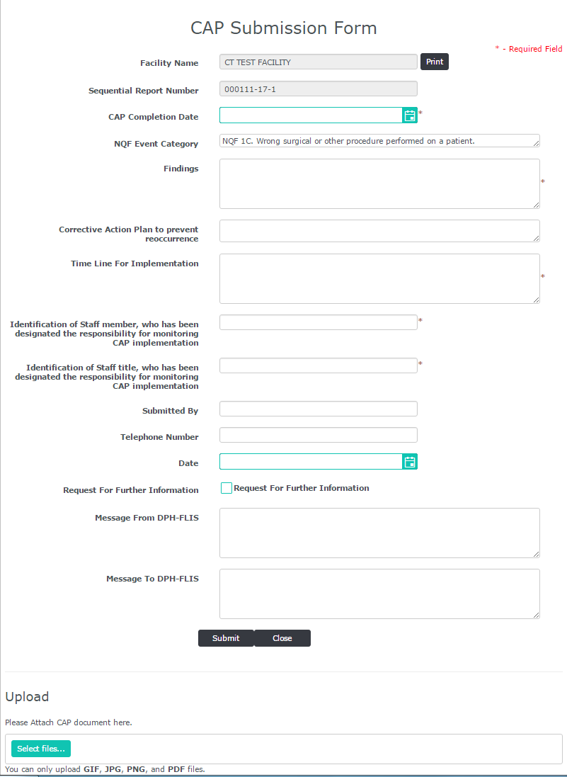
CAP Submission
Applicant needs to complete:
Consent Form
Fingerprinting Information Form
Fill the CAP details and click the “Submit” button at the bottom of the page
There is an option to attach files if needed. Click “Select Files” button and upload the document necessary for the Corrective Action Plan.
“Print” option lets you print the CAP form.
Notes:
Before adding an applicant, need to print the blank Consent Form and Fingerprinting Information Form and give them to the applicant to be filled out.
Certain particulars need to be obtained. That’s why they’re required. This information is from the Fingerprinting Information Form.

Slide 17
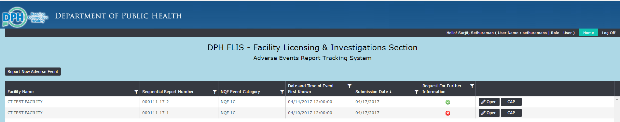
CAP Submission
Applicant needs to complete:
Consent Form
Fingerprinting Information Form
In case DPH-FLIS needs additional CAP details you will see “Request for Further Information” flag Red.
Once you see the “Request for Further Information Flag”, click the “CAP” button to open it and provide more information as requested.
Notes:
Before adding an applicant, need to print the blank Consent Form and Fingerprinting Information Form and give them to the applicant to be filled out.
Certain particulars need to be obtained. That’s why they’re required. This information is from the Fingerprinting Information Form.

Slide 18
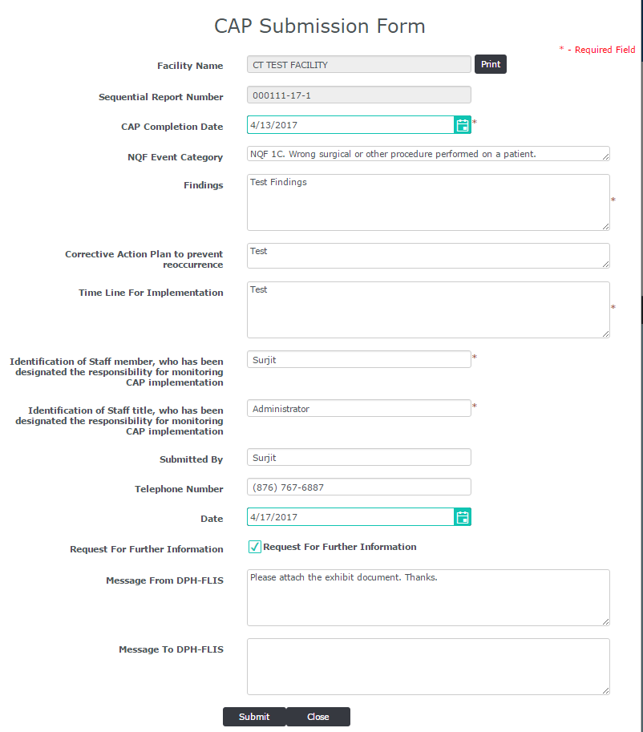
CAP Submission
Applicant needs to complete:
Consent Form
Fingerprinting Information Form
Under “Message from DPH-FLIS” box you will see the notes from DPH-FLIS personnel.
Provide additional information requested and add your notes in “Message to DPH-FLIS” box and click Submit.
Notes:
Before adding an applicant, need to print the blank Consent Form and Fingerprinting Information Form and give them to the applicant to be filled out.
Certain particulars need to be obtained. That’s why they’re required. This information is from the Fingerprinting Information Form.

Slide 19
Authorized User Submission/Registration
Please submit the authorized users for your facility in the below survey link. Only these users will be approved and will have access to the Adverse Events Reporting Tracking system.
Survey Monkey Link: https://www.surveymonkey.com/r/AEUser
Deadline date for submitting the authorized user is 4/28/2017
Once the survey is completed please ask the users to register themselves in the Adverse Events Report Tracking System.
Adverse Events Report Tracking System web link https://dphadverseevents.ct.gov
The Accounts will be activated on the Go-Live date(5/10/2017).

Slide 20
Questions?

Slide 21
Thank You

