Slide 1
CT 2018/19 Continuing Education State Occupational P1 & P2 Plumbing License Holders
Insert Name of provider
Notes:
Instructors should have copies of IPC, IMC, IRC, NFPA 31, 54, 58 and 99. As well as the IECC and the CT Building Code Supplement. Instructors should not be reading slides verbatim but should be come familiar with the slides. One suggestion would be to make notes under each slide that highlights the slide. You should be able to project the power point slide without showing your notes on the screen while being able to see your notes on your computer. The only issue with this method is the instructor will be tied to their desk or podium.

Slide 2
House Keeping
Emergency Exits
  Where to assemble in case of evacuation.
Restroom locations
Breaks, including lunch
Cell off or on vibrate
Have you signed in?
Instructor(s) introduction

Slide 3
Course Topics
List of Codes
Water Heater Code review
Third Party Certification
F.O.G.
N.F.P.A related information
2015 IPC Significant Changes
Dryer vents, (do’s and don’ts)
Permit exempt activities

Slide 4
Course Topics (continued)
9. Geothermal Regulations Update
10. Combustion Air IRC,
11. Penetrations
12. Posting of inspections
13. Changes Dept. Health/DEEP dry wells for Low Flow Wastewater Treatment.
14. Apprentice Ratio changes
15. IECC

Slide 5

Course Topics (continued)
16. Lead Safety
17. Ladder Safety
18. NFPA 99 Medical Gas

Slide 6

Topic 1—Codes
Notes:
The instructor should have access to the internet to demonstrate to the students how to go on line to look at any code for free. Demonstrate how
the codes can be found on line for free. The instructor may also want to bring up the DAS web site as well as talk about the Codes and Standards Committee.

Slide 7

CODE | Year | Code Description
ICC/ANSI A117.1 | 2015 | Accessible & Usable Building & Facilities
IPC | 2015 | International Plumbing Code
IMC | 2015 | International Mechanical Code
IRC | 2015 | International Residential Code
IECC | 2015 | International Energy Conservation Code
 | 2018 | CT Building Code (to be adopted)
NFPA 54 |  | Natural Gas
NFPA 55 |  | Installation of bulk medical gas systems
NFPA 58 |  | Liquefied Gas
NFPA 99 |  | Medical Gas and Vacuum Systems
Notes:
NFPA codes 2018 CT Fire Prevention Code- Inform the students that the 2018 CT Building Code needs to be adopted before the CT Fire Prevention Code goes in affect.Tell students that they should go online and seek changes between the 2016 and 2018 CT Building Code.

Slide 8
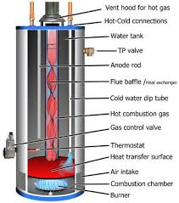
Topic 2
Water Heater
Code Review
Notes:
IPC and IMC required for this section.

Slide 9
Water Heaters
Elevation of water heaters and spark producing equipment in garages
Water temperature limitations
Relief valve discharge
Required pan under water heaters
Pans and tankless water heaters and pan drain termination. Finished basement requirements.

Slide 10
Elevation of water heaters and spark producing equipment in garages.
IMC Section 304.3 Elevation of ignition source.
Equipment which has an ignition source must be installed so that the source of ignition is a minimum of 18” above the floor if installed in any hazardous location, private or public garage, repair garage or auto fuel dispensing location.
If the equipment is located in a non living space and connects directly with a garage, it is considered as part of the garage.
The exception to raising the equipment shall be if the equipment is listed as flammable vapor ignition resistant.
Notes:
Section 502.1.1 of the IPC refers you to this section of the IMC. Explain to the students the use of code books and how they relate to each other.

Slide 11
Water Temperature Limitations
IMC Section 1002.2.2 Temperature Limitations
Addresses combination potable water heating and space heating systems of temperatures exceeding 140° F.
System requires a mixing valve conforming to ASSE 1017 that will reduce the potable water temperature to 140° F.
If the potable water supplies either/or a bathtub or shower, the temperature must be reduced to a maximum temperature of 120° F, as per sections 424.3, 424.4 and 424.5 of the IPC.
Notes:
In the case of the majority of residential systems, potable hot will be 110° F. This is due to the fact that there would only be a single system supplying for the tub/shower, dishwasher, sink and lavatory. A question to ask the class may be, “Where may you encounter separate systems for shower and lavatories?”

Slide 12
Water Temperature Limitations
The maximum temperature for hand washing shall not exceed 110°F IPC section 607.1.2. A mixing valve conforming to ASSE 1070 must be used for this purpose.
Temperature control information can also be found in section P2802.2 of the IRC

Slide 13
Relief Valve Discharge
IPC Section 504.6 Requirements for discharge piping.
Cannot be connected directly to the DWV system.
Must discharge through an air gap.
Minimum size of drain line, is outlet size of relief valve.
May only be used for one relief valve.
Terminate to floor, pan being used by water heater, to a drain or outside.

Slide 14
Relief Valve Discharge.
6. Pipe termination—Pipe must not discharge as to cause personal harm or damage to the building.
7. Discharge point must be readily observable to occupants of the building.
The line itself shall not be trapped
Discharge must be able to flow by gravity.

Slide 15
Relief Valve Discharge
10. Termination—Maximum of 6” but not less than two pipe diameters of the discharge pipe above the floor or flood rim of receptacle.
11. Shall not have a threaded connection at the discharge end.
12. Shall not have tee fittings or valves.
13. Shall be of a material listed in Section 605.4 or materials in accordance with ASME A 112.4.1.
Notes:
Question to students. If the size of the discharge line is ¾”, what is the closest the line can end to the floor or top of the rim of the pan? Answer 1 ½”

Slide 16
Required pan under water heaters.
IPC Section 504.7 Required pan.—Pans are required where leakage from a water heater can cause damage.
Pans shall be galvanized steel 24 gauge.
Pans approved for such use may also be used.
IPC Section 504.7.1 Pan size and drain.
Minimum 1 ½” tall
Drain line minimum ¾”
  Piping material for drain line listed in Table 605.4
Notes:
Installed pans are usually manufactured to these specifications however, if a mechanic builds their own, it must be to this specification.

Slide 17

Pans and tankless water heaters and pan drain terminations. Finish basement requirements.
IPC Section 504.7.2
Extend full size to a place of termination
Termination point shall be either a floor drain or outside of the building.
Terminate not less that 6” or more than 24” above the surface of the ground.
Drain pan not required for a replacement if DWV system is overhead or the termination point of the discharge line is below grade.
Notes:
These numbers are for the pan drain and NOT the relief line discharge.

Slide 18

Topic 3 Third Party Certification

Slide 19
Third Party Certification
A third party certification agency is defined as an agency that is approved to certify that a product or material has met a standard through testing, assessment and surveillance of a manufacture’s quality control system.
Third-party certification means that an independent organization has reviewed the manufacturing process of a product and has independently determined that the final product complies with specific standards for safety, quality or performance.

Slide 20

Some Third Party Certifiers
AGA—American Gas Association
ASSE—American Society of Sanitary Engineers
ASTM—American Society for Testing Material
CSA—Canadian Standards Association
NSF—National Sanitation Foundation
UL—Underwriters Laboratories
Others????
Notes:
PSI Exams tests for occupational licenses in CT, NITC, National Inspection and Testing Certification. Used by CT for medical certifications. ANSI, American National Standards Institute.

Slide 21

Topic 4 Fats, Oils and Grease (F.O.G)

Slide 22
Fats, Oils and Grease
1003.3.6 Gravity Grease Interceptors and Gravity Grease Interceptors with Fats, Oils and Greases Disposal Systems.
Previously the IPC did not address or regulate gravity type grease interceptors because there were no regulations regarding standards of construction.
Most of these types of tanks are found underground.
By reducing the flow rate of the waste water through the grease interceptor, solids will sink to the bottom of the trap while the grease will float on the top.
The cleaning intervals of gravity grease interceptors can be reduced by fitting them with F.O.G. systems.
Notes:
The instructor must have a copy of the 2015 IPC for this section. CT required a general permit as of October 2015.

Slide 23

Fats, Oils and Grease
1003.3.7 Direct Connection of Grease Interceptor Discharge.
Designing plumbing system which required grease interceptors in new buildings generally does not create a problem. However this could be a problem in an existing structure.
Until the 2015, an indirect connection to a floor sink was allowed.
The standard now requires a direct connection to the sanitary system.

Slide 24
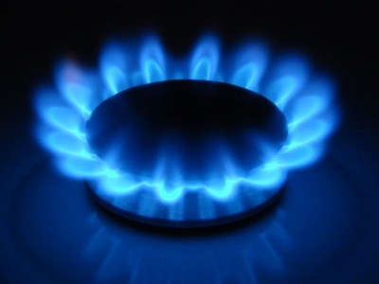
Topic 5 NFPA related information
Notes:
Instructors will need copies of the IPC, IMC, IRC, NFPA 54, 58 (CT Fire Prevention Code) and the CT Building Code.

Slide 25
7.13 Electrical Bonding
7.13.1 Pipe and Tubing Other than CSST:
  All and any portion of above ground gas piping shall be grounded which may become charged electrically must be grounded to a proper grounding path . If material other than CSST is used, it shall be deemed as bonded if is connected to an appliance that is properly bonded.
Notes:
Information on Bonding can also be found in section G2411 of the IRC. Plumbers are NOT allowed to connect to the grounding bar in an electrical panel. This must be done by a licensed electrician. Plumbers are allowed to bond to CSST to water piping. The proper size wire must be used. See further regulations from CT State Building Official Document.

Slide 26
7.13 Electrical Bonding
7.13.2 CSST:
  Tubing must be grounded to the electrical service grounding system.
    Minimum of 6 AWG copper wire.
    Connect to metal pipe or fitting that is located within delivery point and first CSST fitting.
    System containing one or more sections of CSST must be bonded in accordance with this section.

Slide 27
7.13 Electrical Bonding
7.13.3 Prohibited Use:
  The use of gas piping as a ground is prohibited
7.13.4 Lightning Protection:
  Lightning protection systems installed to N.F.P.A. 780 are within a structure. Bonding of the gas piping must conform to that standard
7.13.5 Electrical Circuits:
  Gas piping or its components shall not be used as an electrical circuit.

Slide 28
8.1 Pressure Testing & Inspection
A visual and pressure test must be made before acceptance of a system.
Any repairs made to the system after initial testing shall be retested and inspected.
  If repairs are minor they may not be required to be pressure tested. However they must be tested with an approved leak detector.
If a new branch is added to an existing system, only that branch shall be required to be tested.

Slide 29
8.1 Pressure Testing & Inspection
Piping may be tested in sections or whole.
Fabricated sections may be tested with an inert gas prior to installation.
  Gas valves shall NOT be used as stops between a live system and a section of a system being tested.
    Exception if two valves are installed in series.
Before any testing can occur, the interior of the piping shall be cleared of all foreign material.

Slide 30
8.2 Test Medium
Gases allowed for testing purposes…
  Air
  Nitrogen
  Carbon dioxide
  Or an inert gas
OXYGEN SHALL NEVER BE USED FOR TESTING PURPOSES.

Slide 31
8.1.3 Test Preparation
All joints must be exposed for testing
Appliances shall NOT be connected to the system when being tested.
  Piping downstream of a blind flange connected to equipment shall NOT be required to be tested.
Testing shall be preformed in a safe manner.

Slide 32
8.1.4 Test Pressure
When testing, pressure shall be measured with either a manometer of test gage.
  Manometer/gauge must be calibrated to read any pressure loss.
  Mechanical gauges shall NOT register more than 5X the test pressure.

Slide 33
8.1.4 Test Pressure
Test pressure must be no less than 1 ½ times the working pressure but in any case never lower than 3 PSI.
  Testing that exceeds 125 PSI. Pressure shall NOT exceed 50% of the rated pressure of the rating
Test pressure shall be maintained for a minimum of ½ hour for every 500’ of line.
  Single family or systems with 10 cubic feet may be held for a minimum of 10 minutes.
Testing of propane systems (NFPA 58 section 6.14) shall be as per NFPA 54.

Slide 34
8.1.5 Detection of Leaks & Defects
When pressure loss is indicated on the gage, it shall be deemed that there is a leak within the system.
Testing to located the leak(s) shall be done by an approved method.
  ANY type of open flame or source of ignition shall note be used for testing
When the leak(s) is located, the piping, fitting or cause of the leak shall be repaired or replaced if necessary.

Slide 35
8.3 Purging Requirements
8.3.1 Piping Systems Required to be Purged Outdoors:
  Gas pressure greater than 2 psig or
  Contains 1 or more sections in table 8.3.1
Nominal Pipe Size (inches) | Length of Piping (feet)
> 2 ½ <3 | >50
> 3 <4 | >30
> 4 <6 | >15
> 6 <8 | >10
> 8 | Any length
Notes:
Purging information can also be found in section G2417.7 of the IRC

Slide 36
8.3 Purging Requirements
8.3.1.1 Removal from Service:
  Open section of existing gas line.
    Shall isolated from the gas supply.
    Pressure vented as per 8.3.1.3.
    Inert gas shall displace residual fuel gas.
Placing in Operation:
  Piping meeting table 8.3.1 and containing air…
    Air first purged with inert gas.
    Inert gas then replaced with fuel gas.
Notes:
The requirement of using an inert gas for purging is a direct result of the Middletown powerhouse explosion. Although this was not the first accident of this kind.

Slide 37
8.3 Purging Requirements
Outdoor Discharge of Purged Gases.
  A shutoff valve shall be installed at the point of discharge to control the purge.
  Point of discharge,
    10’ from ignition sources,
    10’ from opening in structures,
    25’ from mechanical intake openings
  Continuously monitored by attendant with a 8.3.1.4 compliant combustible gas indicator.
  When fuel gas volume within the pipe reaches 90%, purging with fuel gas shall be stopped.
  No persons not involved with the purging process shall be within 10’ of the discharge of the purge.

Slide 38
8.3 Purging Requirements
8.3.1.4 Combustible Gas Indicator.
  Must be…
    Listed
    Calibrated as per manufacture
    Have a volume scale of 0-100%
      Volume scale 1% or smaller increments.
Notes:
This is not necessary but one of the different types of methods. NFPA has now adopted a special code regarding this.

Slide 39
8.3 Purging Requirements
Piping Systems Allowed to Be Purged Indoors or Outdoors:
  Must meet one of the following…
    Operating design pressure 2 pisg or less
    Pipe being purged made entirely of pipe or tubing which does not meet any of the criteria of Table 8.3.1.

Slide 40
8.3 Purging Requirements
8.3.2.1 Purging Procedure.-One or more of below
  Purging with fuel gas shall be outdoors
  If purged indoors or outdoors and supplies with an appliance burner, not located in a combustion chamber. The burner shall have a continuous source of ignition.
  Piping being purged, indoors or outdoors, using a burner with a continuous ignition source shall be designed for that purpose.

Slide 41
8.3 Purging Requirements
8.3.2.1 Purging Procedure.-Continued
4. Piping purged either indoors or outdoors shall be monitored with combustible gas detector as per 8.3.2.2. Purging must halt when gas is detected.
5. The purging must done by the gas supplier in accordance with written documents.

Slide 42
8.3 Purging Requirements
8.3.2.2 Combustible Gas Detector.
  Must be listed and calibrated as per the manufacturers instructions. Must be able to indicate the presence of fuel gas.
8.3.3 Purging Appliances and Equipment.
  Once a fuel gas piping system is operational, all appliances and equipment must be purged before being brought into operation.

Slide 43

NFPA 54-58
NFPA 58 tank installation covers installation to the second stage regulator.
IRC Chapter 24 is residential gas piping.
NFPA 58 commercial is tank to inside building or second stage regulator.
NFPA 54 is commercial gas piping.

Slide 44

Topic 6
Significant Changes Between the 2012 and 2015 International Plumbing Code
Notes:
It should be explained to the students that due to copyright laws we are not allowed to give the actual changes to the code. We have summarized these changes to make the license holder aware and impress upon them the need to update what they are using for code books. Instructors must have either a copy of the 2015 IPC or a copy of the 2015 Significant Changes book with them during this section. They will need them to go thru them if questioned on the actual changes.

Slide 45
2015 International Plumbing Code
The State of CT is scheduled to adopt the 2015 International Plumbing and Mechanical codes in 2018.
There are 15 chapter in the IPC. Chapters listed below have not had any significant changes.
  Chapter 1 Scope and Administration
  Chapter 12 Special Piping & Storage Systems
  Chapter 13 Non-potable Water Systems
  Chapter 14 Subsurface Land Irrigation Systems
  Chapter 15 Referenced Standards

Slide 46
Chapter 2: Definitions
Alternate Onsite Non-potable Water Definition (addition)
  New term has to support a revised Chapter 13 that encompasses how different non-potable waters are to be collected, stored and distributed
Backflow Preventer Definition (modification)
  Definition has become more specific regarding what is a backflow preventer: a backflow prevention assembly, a backflow prevention device or other means or methods of preventing backflow.

Slide 47
Chapter 2: Definitions
Drinking Fountain, Water Cooler and Water Dispenser Definitions; Substitution for Drinking Fountains (modification)
  New definitions clear up section 410 on drinking fountain requirements and the water dispenser definition enlarges what is considered to be a water dispenser. It also allows water dispensers to be allowed as substitutes for 50% drinking fountain requirements.
Grease Interceptor, Definition of Fats, Oils and Greases (FOG) Disposal Systems (addition)
  There has been a text revision in Section 1003.3.4 which covers grease interceptors. The new definition of a Fats, Oils and Greases system has been included to support that text change.

Slide 48
Chapter 2: Definitions
Mechanical Joint Definition (modification)
  Heat-fused joints are now defined as mechanical joints.
Toilet Facility Definition (addition)
  New definition to spell out that a toilet facility is a room or space that contains not less than one water closet and one lavatory
Water Receptor Definition (addition)
  New definition added to clear up what is considered a waste receptor.

Slide 49
Changes Chapter 3:
General Regulations
Table 308.5 Mid-Story Guide (modification)
  In Table 308.5 of previous codes, there was a requirement for mid story guides 2” and under for some pipes. This was located in footnote “b”. The code never defined exactly what a mid-story guide was which misunderstanding as to what they were and what was required to install them.

Slide 50
Chapter 4: Fixtures
403.1 Determining Minimum Number of Plumbing Fixtures (modification)
  Occupancy classifications A, B, and C of the IBC used in determining where within Table 403.1 are no longer used. Fixture quantities will be determined by the actual use of the building or space.
403.3 Required Public Toilet Facilities Exception (modification)
  Public limited access occupancies, [300ft² or less], such as dry cleaners, take-out only restaurants and automated teller machine lobbies, do not require public toilet facilities .

Slide 51
Chapter 4: Fixtures
403.4.1 Directional Signage for Location of Public Toilet Facilities (modifications)
  The main entrance to the building or tenant space is now required to have directional signage for public toilet facilities
406.1, 409.2 Backflow Protection for Clothes Washing and Dishwashing Machines (modification)
  This change will allow the code enforcement official to check that the appliance meets the required backflow protection by identifying the standard number either on the appliance or in the literature for the appliance. Thereby not requiring the enforce official to see the protection method on the appliance.

Slide 52
Chapter 4: Fixtures
410.4 Substitution
  Restaurants shall not be required to have drinking fountains if they provide drinking water in a container free of charge. If a facility is required to have drinking fountains, water coolers may be allowed to replace up to 50% of the required drinking fountains.

Slide 53
Chapter 4: Fixtures
413.1 Food Waste Disposer Approval (modification)
  Industry-accepted terminology for food waste grinders are now the accepted term. For electrical safety, The standard requires that domestic food waste disposers must be listed and labeled. This to comply with electrical safety.

Slide 54
Chapter 4: Fixtures
  417.4.1 Walls and Floors in Bathtub and Shower Areas (modification)
    This section was modified to clarify the watertight requirements as well the requirement of using material that is durable when wet, for tub and shower floors as well as walls.
420.1 Water Closet Approval (modification)
  The code has incorporated a standard to address Dual-flush water closets.

Slide 55
Chapter 4: Fixtures
421.1 Whirlpool Tub Approval (modification)
  An electrical standard has been added to this section.
423.3 Footbath, Pedicure Baths and Head Shampoo Sinks (addition)
  A device which limits the outlet water temperature are required on the above fixtures.
434.8 Deck-Mounted Bath/Shower Transfer Valves (modification)
  The ASME requirements for deck-mounted bath/shower transfer valves has been changed.

Slide 56
Chapter 5: Water Heaters
501.3 Water Heater Drain Valves (modification)
  The drain valve standard has been removed. A minimum of a ¾” drain size has been added. It also require a male garden hose thread.
504.6 Temperature & Pressure Relief Discharge Piping (modification)
  Terminology requiring an air gap.
504.7.2 Water Heater Pan Drain Line (modification)
  Allows for a drain pan not to have a drain line if there is no place for the line to drain to.

Slide 57
Chapter 6: Water Supply & Distribution
601.5 Rehabilitation of Piping Systems by Internal Lining (addition)
  Piping is now allowed to be lined with an epoxy coating
605.2.1 Lead Content of Components Conveying Drinking Water (addition)
  The allowable lead content has now gotten stricter.
Tables 605.3 & 605.4, Section 605.16 CPVC/AL/CPVC Water Service & Water Distribution Piping (addition)
  Covers a new type of PVC piping.

Slide 58
Chapter 6: Water Supply & Distribution
Tables 605.3, 702.2, 702.3, 702.4, 1102.4 1102.5 Asbestos Cement Pipe (modification)
  Asbestos cement piping has been removed from the tables.
Table 605.5, Sections 605.14.3, 605.14.5, 605.18.3, 605.22.2 605.23.3 (modification)
  New standard addressing grooved and shouldered mechanical joints.
605.7 Table 604.7 Valve Compliance to Standards (modification)
  NSF 61 is now the standard for all types of drinking water valves as well as many others that have been added to this standard

Slide 59
Chapter 6 Water Supply & Distribution
607.2.1 Hot Water Temperature Maintenance System Controls (modification)
  The IECC has introduced changes which effect the section of the IECC within the IPC.
607.3 Hot Water Thermal Expansion Pressure Control (modification)
  Only thermal expansion tanks may be used to control a closed system.
608.8, 608.8.1 608.8.2 Identification of Nonpotable Water (modification)
  Purple in now the color for non-potable water lines. Any WC or urinal using non-potable water must be identified.

Slide 60
Chapter 7: Sanitary Drainage
702.5 Temperature Rating of Drainage Piping (addition)
  When drainage piping is rated at 140°F, water being discharged into the system does not need to be cooled.
703.6 Connection to Combined Sanitary and Storm Public Sewer (addition)
  When connected to a combination sanitary and storm drainage system, the systems must remain separate within the building

Slide 61
Chapter 7: Sanitary Drainage
705.11.2 Exception for Solvent Cementing PVC Piping 4” and Smaller (modification)
  If solvent cement is 3rd party certified to ASTM D 2564. Primer will not be required for pipe 4” and smaller pipe.
708 Cleanouts for Drainage & Waste Systems (modification)
  There has been a complete reorganization on the section on cleanouts. An example: Cleanouts are no longer required at the base of each stack.

Slide 62
Chapter 7: Sanitary Drainage
715.1 Exception for Backwater Valve Installation (modification)
  An exception for the installation for backwater valves in existing building that where the fixtures are higher than the next upstream manhole on a public system.
716 Vacuum Drainage Systems (addition)
  Vacuum drainage system have relocated to the code from the appendix.

Slide 63
Chapter 7: Sanitary Drainage
717 Replacement of Sewers by Pipe Bursting Method (addition)
(INCERT 1:25 MINUTE VIDEO FROM YOUTUBE INTO POWER POINT.)
Notes:
There is a 1:24 video on YouTube showing this process

Slide 64
Chapter 8: Indirect/Special Wastes
802.1, 802.1.1, 802.1.8 Food Handling Equipment Indirect Connection (modification)
  Section cleaned up to not include fixtures or equipment in dwelling units.
802.3 Waste Receptors, Hub Drains and Standpipes (modification)
  There is a clarification on standpipes being waste receptors as well as now requiring hub drain to have strainers. Some restrictions on waste receptors locations have been removed.

Slide 65
Chapter 9: Vents
903.1, 903.2 Vent Terminations to Outdoors (modification)
  This change is a clarification on vent extensions through roofs used for other than weather protection.

Slide 66
Chapter 10: Traps
1002.1 Exception for Traps for Parking Garage Floor Drains (modification)
  If a garage floor drain is connected to a storm drain, a trap is not required.
1002.4, 1002.4.1 Trap Seal Protection against Evaporation (modification)
  There are now different approved methods of protecting trap seals.
1003.3.6 Gravity Grease Interceptors (addition)
  A gravity grease interceptor section has been added to the code. (Topic 3 F.O.G.)

Slide 67
Chapter 10: Traps
1003.7 Direct Connection of Grease Interceptor Discharge (addition)
  Piping from grease interceptors must connect directly with the sanitary system.
1003.4 Oil Separator Required (modification)
  A clarification addressing where oil separators are required has been made as well as an addition to the exception.

Slide 68
Chapter 10: Traps
1003.6 Clothes Washer Discharge Interceptor (modification)
  Clothes washer discharge interceptor requirements has been clarified.
1003.9 Venting of Interceptors and Separators (modification)
  Vents required for separators and interceptors.

Slide 69

Chapter 11: Storm Drainage
1105.2, 1106.2 Sizing of Roof Drains, Vertical and Horizontal Storm Drain Piping (modification)
  It has been found that the roof drain assembly is the limiting factor in storm drain design. Published drain flow rates and piddling must now be used when sizing storm drain piping
1106.3, 1106.6 Sizing of Gutters and Leaders (modification)
  Table 1106.2 has been replaced. Table 1106.6 has been made easier.

Slide 70
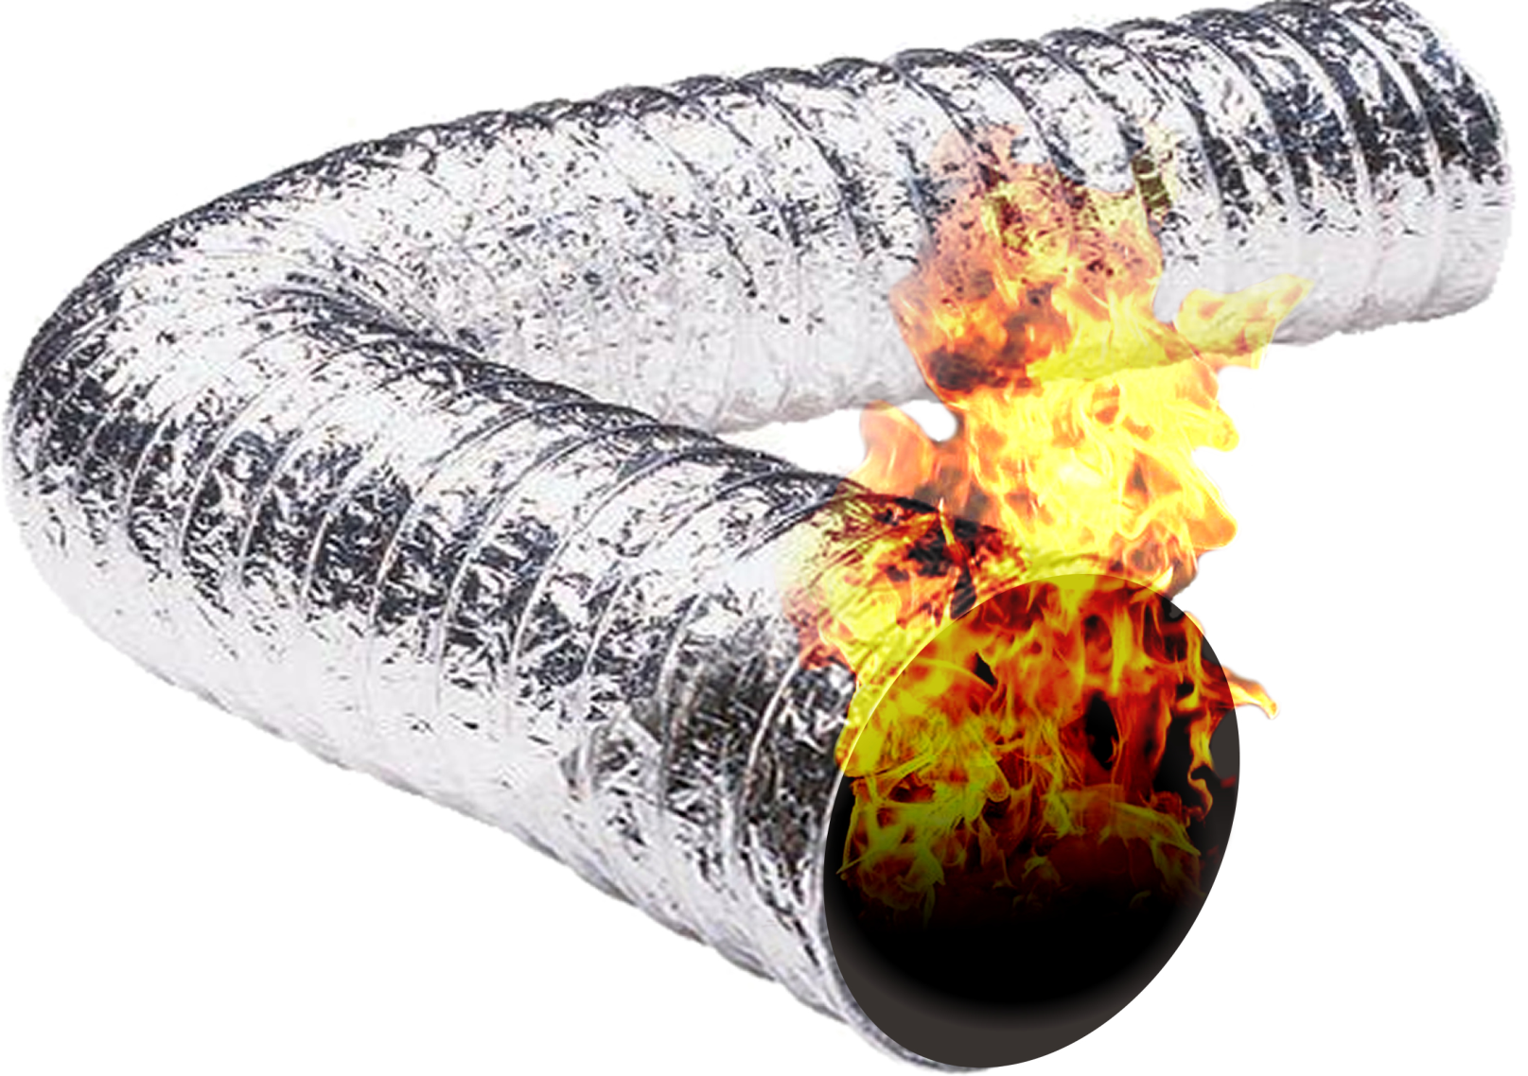
Topic 7 Dryer Vents
Notes:
The presenter must have a copy of the 2015 IMC for this section.

Slide 71
Dryer vents
IMC Section 504 Clothes Dryer Exhaust
504.1 Installation
  Exhausted as per manufactures instructions.
  Must be independent of other systems.
  Convey moisture and products of combustion outside of the building
    Exemption—if listed or labeled as a ductless dryer.
Notes:
This IMC section is for three family and above, including commercial. IRC reflects on one and two family residential, including townhouses.

Slide 72
Dryer vents
504.2 Exhaust penetrations
  Wall/ceiling penetrations must be sealed with non combustible, approved fire caulking or non combustible dryer exhaust duct wall receptacle.
  Shall not be located or penetrate any fire blocking, draft stopping or fire resistance wall as listed in the International Building code unless is constructed of galvanized steel or aluminum as list in table 603.4. Anything that constrict the flow, e.g. smoke/fire damper cannot be installed in the duct.

Slide 73
Dryer vents
504.3 Cleanout
  All vertical risers must have a cleanout.
504.4 Exhaust installation
  Exhaust installed outside of the building must have a backdraft damper. Screens shall not be allowed.
  Screws or other fasteners that will obstruct the exhaust flow shall not be used to connect ducts.
  Vents may not connect to a vent connector, vent or chimney.
  They shall not penetrate into or through ducts or plenums.

Slide 74
Dryer vents
504.5 Dryer exhaust duct power ventilators
  Must be listed and installed as per manufacturers instructions.
504.6 Makeup Air
  Makeup air must be supplied if the dryer is exhaust 200 CFM or more.
  For dryers installed in closets, either make up air or an opening of 100 square inches must be provided.

Slide 75
Dryer vents
504.7 Protection required.
  If place where nails or screws from any work may likely penetrate the vent, a shield plate shall be installed.
  Shield plates on the finished face of all framing where the framing is less than 1 ¼” from the framing. Shields must be a minimum of 0.062” thick and extend 2” above a sole plate and 2” below a top plate.

Slide 76
Dryer vents
504.8 Domestic clothes dryer ducts.
  Domestic clothes dryer ducts must meet the following…
504.8.1 Material and size.
  Must have a smooth interior
  Must be a minimum of 0.016 thick.
  Must be a minimum of 4”
504.8.2 Duct installation.
  Must be supporter every 4’
  When connecting the ductwork the insert shall be installed in the direction of flow.
  The maximum a screw or similar fastener shall protrude into a duct shall be 1/8”.

Slide 77
Dryer vents
504.8.3 Transition ducts.
  Shall be listed and labeled UL 2158A
  8’ maximum length & not concealed with construction.
504.8.4 Duct length.
  As per 504.8.1—504.8.3
504.8.4.1 Specified length.
  35’ shall be the maximum duct length from the connection to the transition ductwork .
  If fitting are installed, the length shall be reduced as per Table 504.8.1

Slide 78
Dryer vents
504.8.4.2 Manufacturers instructions.
  The manufacture shall determine maximum length of the exhaust.
  Code official shall be given a copy of the manufacturers installation instructions for the dryer installed.
  If the ductwork is to be concealed, the code official shall be given the installation instruction before the ductwork is hidden.
  Table 504.8.1 shall be used if manufacturer does not supply fitting equivalent length information.

Slide 79
Dryer vents
504.8.4.3 Dryer exhaust duct power ventilator length.
  The manufacturer shall determine the maximum allowable duct length.
504.8.5 Length identification
  A permanent label or tag shall be within 6’ of the duct exhaust if the exhaust equivalent length is more than 35’

Slide 80

Dryer vents
504.8.6 Exhaust duct required.
  If a space is provided for a dryer.
  If a space is provided but no dryer install it must be capped off.
    Exception:--if listed condensing dryer installed before the structure is occupied.

Slide 81

Topic 8 Permit exempt activities.

Slide 82

Permit exempt activities.
IPC Section [A] 106.2 Exempt work.
Leak stoppage in drains, water, soil, waste or vent piping. However if piping has to be replaced it shall be considered new work.
Clearing of stoppages.
Repairing of leaks in valves.
Removal and reinstallation of water closets.
If repairs require replacement or rearrangement of valves, pipes or fixtures, a permit shall be required.
Notes:
The presenter must show how to bring up the 2016 CT Supplement on line. Exempt activities are found in section 105.2 of the CT Building Code.

Slide 83
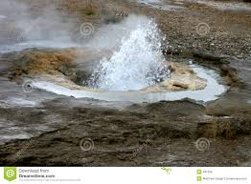
Topic 9 Geothermal Regulations
Notes:
The Geothermal Standards and Codes for CT can be found by googling CT Geothermal Regulations. This is a five page document that the instructor should have on hand for the class to answer any questions.

Slide 84
Geothermal regulations
Ground Source Heat Pumps and their associated earth link loop must meet certain standards in Connecticut.
While the well drilling code has not yet been enacted, the 2011 Health Department Code is being enforced by Sanitarians, with legal separation requirements as outlined in the document, Appendix A 1-5, including a new separation distances between loop pipe and various septic system components and other piping.
Notes:
Appendix A1A through A1E which is located in the back of this booklet.

Slide 85

Geothermal Regulations
ADDITIONAL SUPPORT
1. CT Septic System Regulations
2. Proposed Well Drilling Regulations- not yet enacted
3. Connecticut Clean Energy Fund or Connecticut Energy Efficiency Fund
4. IGSHPA 2010 Standards

Slide 86
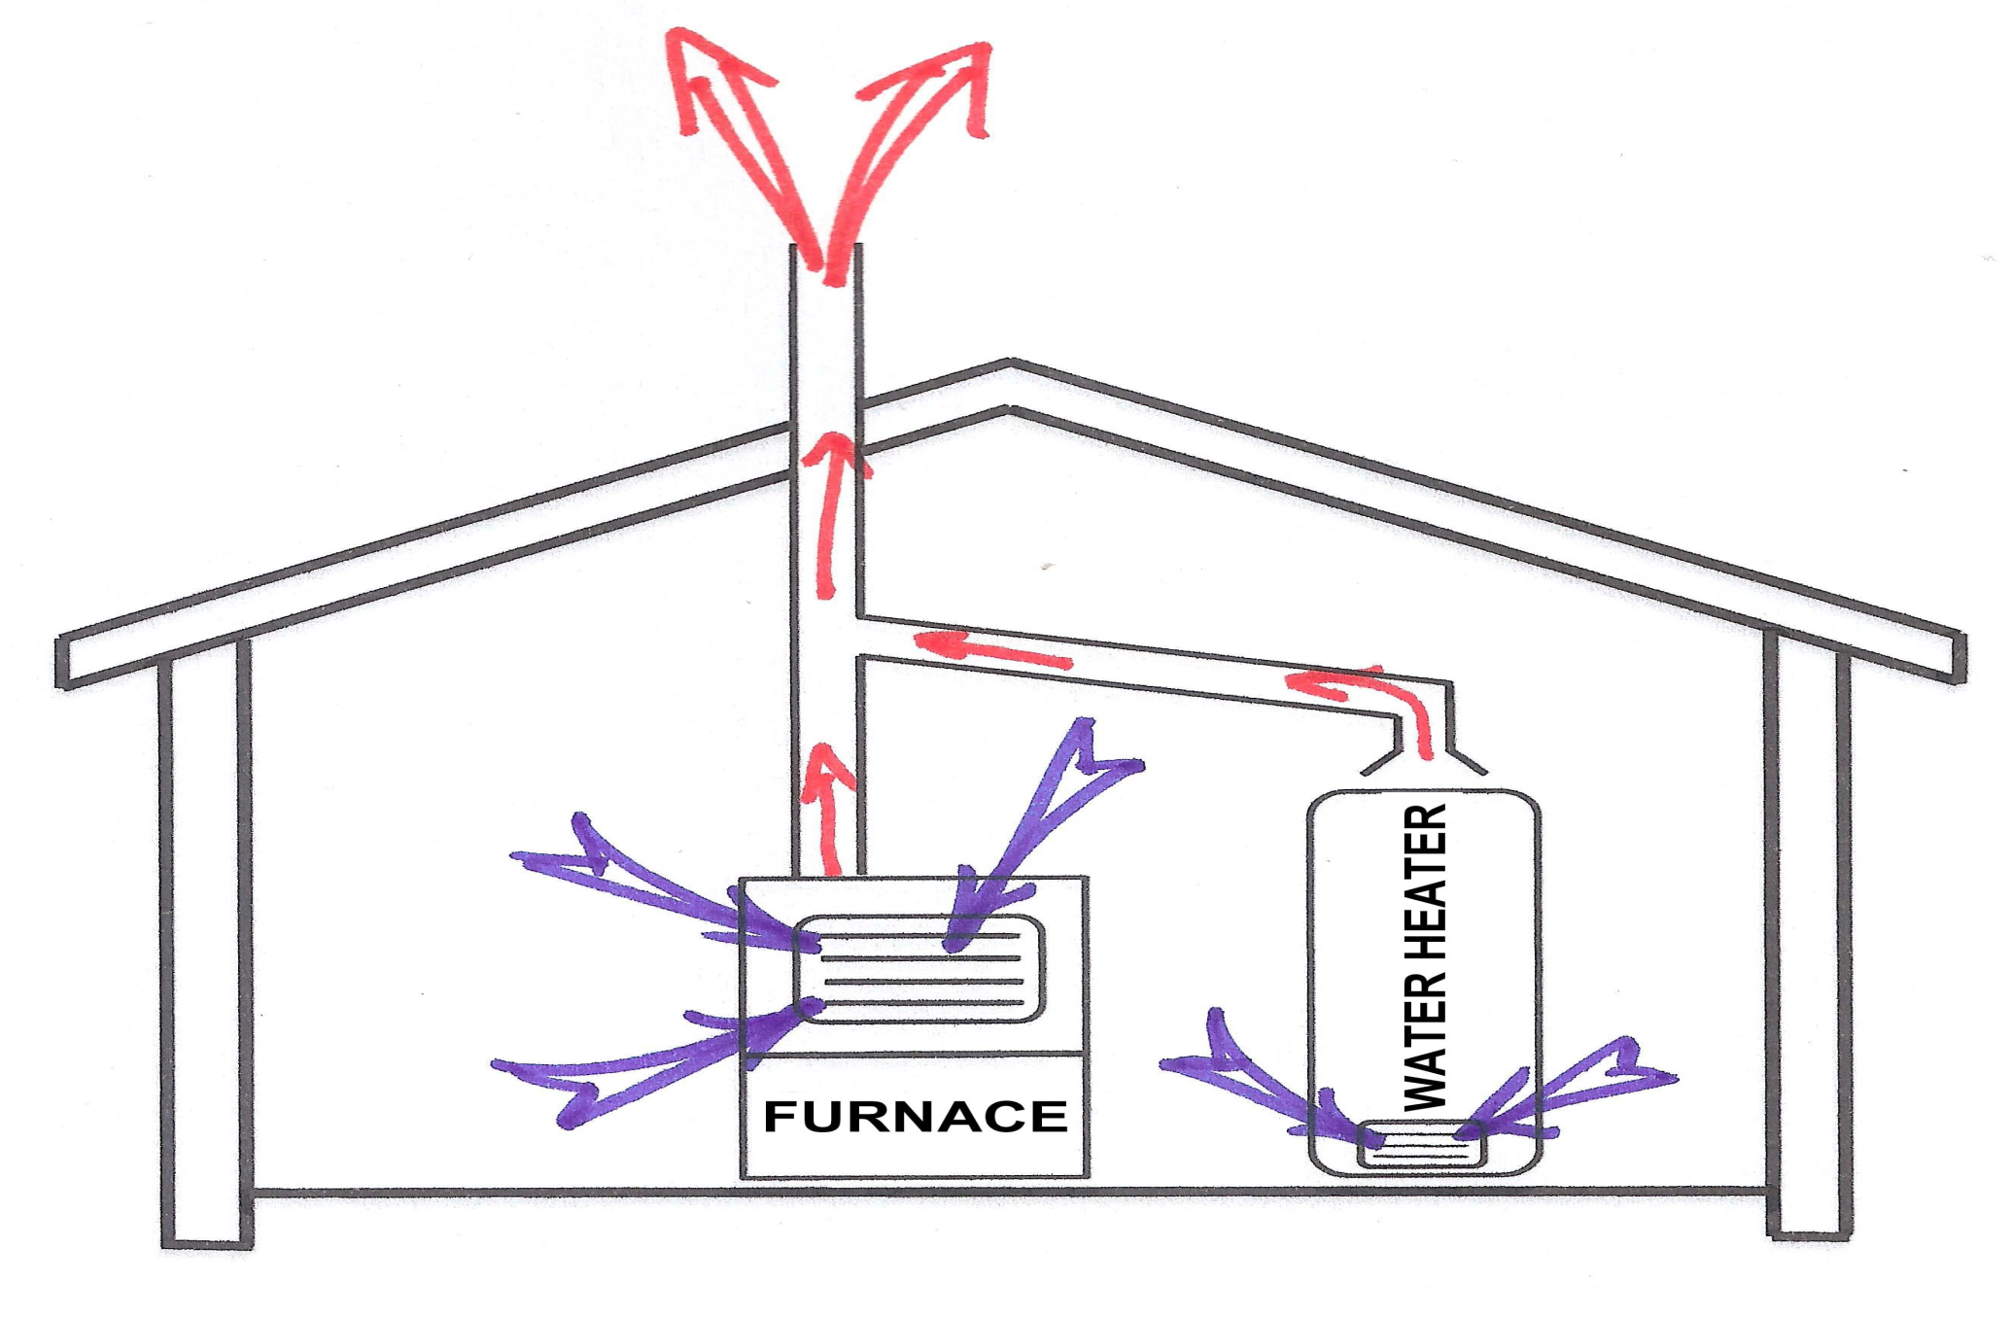
Topic 10 Combustion Air
Notes:
The instructor should have a copy of IRC and NFPA 31 on hand for this section.

Slide 87
2015 IRC Chapter 17
Chapter 17 in the IRC only has two paragraphs. Section 1701.1 addresses scope and section 1701.2 addresses opening location
Notes:
2018 CT Building Code has no amendments and we are unaware of any future changes at this point.

Slide 88
1701.1 Scope
Solid fuel burning applicants shall be installed as to manufacturers specifications
NFPA 31 shall be used for oil fired equipment
Chapter 24 of the IRC shall be used for gas fired equipment.

Slide 89

1701.2 Opening Location
Table R301.2(I) shall establish opening locations in flood hazard areas.
Section R322.2.2.1 or section R322.2 shall establish combustion air opening above elevation required.

Slide 90
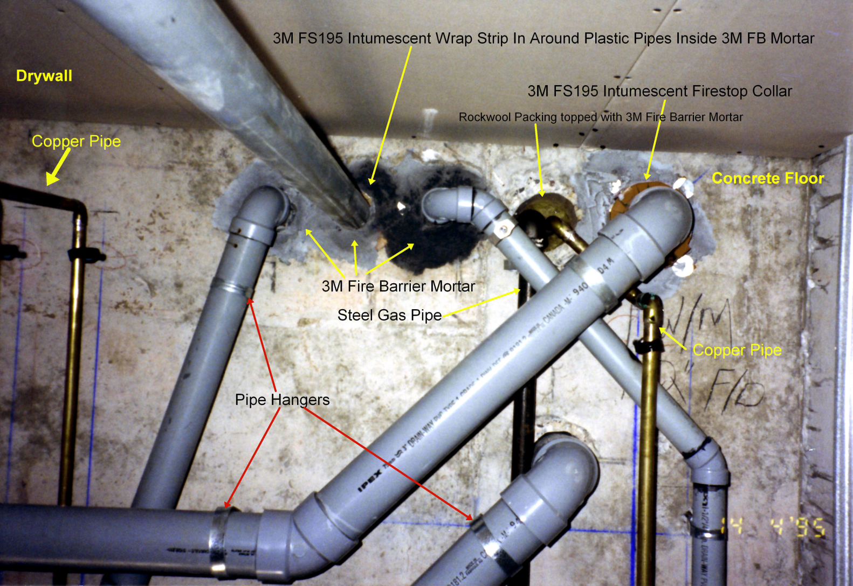
Topic 11 Penetrations
Notes:
The IPC may be used in this section

Slide 91
IPC Section 315 Penetrations
Piping passing through a wall, floor, ceiling, roof or outside of a building must have its annular space sealed with an approved material e.g. caulking material, foam sealant or gasket system.

Slide 92
IPC Section 315 Penetrations
Piping passing through a fire rated partition shall be sealed with an approved fire rated caulking or system.
Penetrations shall comply with section 714 of the International Building Code.

Slide 93
IPC Section 315 Penetrations
903.3 Flashings (Vents)
Vents lines passing through a roof shall be made water tight using an approved flashing.

Slide 94
IMC Section 308 Clearance Reduction
Section 308 governs the requirements for clearances to combustible materials and assemblies…
  Chimneys
  Vents
  Kitchen exhaust equipment
  Mechanical appliances
  Mechanical devices and equipment
Notes:
For three family and above including commercial.

Slide 95
IMC Table 308.4.2 Clearance Reduction Methods
Type of Protective Assembly | Reduced Clearance with Protection (inches)
 | Horizontal combustible assemblies located above the heat source |  |  |  | Horizontal combustible assemblies located beneath the heat source & all vertical combustible assemblies
 | Required clearance to combustibles without protection (inches) |  |  |  | Required clearance to combustibles without protection (inches)
 | 36 | 18 | 9 | 6 | 36 | 18 | 9 | 6
Galvanized sheet steel, having a minimum thickness of 0.0236” (24 gauge), mounted on 1” glass fiber or mineral wool batt reinforced with wire on the back, 1” off the combustible assembly | 18 | 9 | 5 | 3 | 12 | 6 | 3 | 3
Galvanized sheet steel, having a minimum thickness of 0.0236” (24 gauge), spaced 1” off the combustible assembly. | 18 | 9 | 5 | 3 | 12 | 6 | 3 | 3
Two layers of galvanized sheet steel, having a minimum thickness of 0.0236” (24 gauge) having a 1” airspace between layers, spaced 1” off the combustible assembly | 18 | 9 | 5 | 3 | 12 | 6 | 3 | 3
Two layers of galvanized sheet steel, having a minimum thickness of 0.0236” (24gauge) having 1” of fiberglass insulation between, spaced 1” off the combustible assembly | 18 | 9 | 5 | 3 | 12 | 6 | 3 | 3

Slide 96

IMC Table 308.4.2 Clearance Reduction Methods
Type of Protective Assembly | Reduced Clearance with Protection (inches)
 | Horizontal combustible assemblies located above the heat source |  |  |  | Horizontal combustible assemblies located beneath the heat source & all vertical combustible assemblies
 | Required clearance to combustibles without protection (inches) |  |  |  | Required clearance to combustibles without protection (inches)
 | 36 | 18 | 9 | 6 | 36 | 18 | 9 | 6
0.5” inorganic insulating board, over 1” of fiberglass or mineral wool batt, against the combustible assembly | 24 | 12 | 6 | 4 | 18 | 9 | 5 | 3
3 ½” brick wall, spaced 1” off the combustible wall | ---- | ---- | --- | ---- | 12 | 6 | 6 | 6
3 ½” brick wall, against the combustible wall | ---- | ---- | ---- | ---- | 24 | 12 | 6 | 5

Slide 97

Topic 12 Posting of Inspections
Notes:
The instructor should have the CT State Building Code for this section.

Slide 98

Posting of Inspections
2016 CT State Building Code
(Add) 110.1.1 Posting of required inspections. A schedule of required inspections shall be compiled by the building official. The schedule shall be posted in the building department for public view..

Slide 99

Topic 13 Changes DPH/DEEP
Notes:
The report form for this section is found in Appendix A2A through A2C

Slide 100
Low Flow Water Treatment Wastewater—Definition
“Low Flow Water Treatment Wastewater” or “LFWTW” for the purpose of this general permit means a maximum of 500 gallons per day of wastewater generated by a point of entry water treatment device for the treatment of well water used to supply potable water to a residential building or institution or a non-residential building and where the treated water is not purchased by another party but does not include discharges from treatment system components for the removal of radionuclides.
Notes:
Ask the class, so what does all that mean?

Slide 101

Low Flow Water Treatment Wastewater Disposal System—Installation Report Form
Appendix A1—Installation Report Form
Appendix A2—As Built Drawing(s)
Appendix A3—General Permit for the Discharge of Low Flow Water Treatment Wastewater

Slide 102

Topic 14 Apprentice Ratios
Notes:
The next slide will just be a table with the new ratios

Slide 103

Public Act 17-76 effective 6/28/17
Apprentices | Journey persons | Apprentices | Journey persons
1 | 1 | 14 | 36
2 | 2 | 15 | 39
3 | 3 | 16 | 42
4 | 6 | 17 | 45
5 | 9 | 18 | 48
6 | 12 | 19 | 51
7 | 15 | 20 | 54
8 | 18 | 21 | 57
9 | 21 | 22 | 60
10 | 24 | 23 | 63
11 | 27 | 24 | 66
12 | 30 | 25 | 69
13 | 33 | 26 | 72
Apprentices | Journey persons | Apprentices | Journey persons
27 | 75 | 29 | 81
28 | 78 | 30 | 84
Ratio Continues at 3 journey persons to 1 apprentice. Company’s can still apply for ratio relief.
Notes:
The ratio relief application is located in appendix B1 through B3

Slide 104
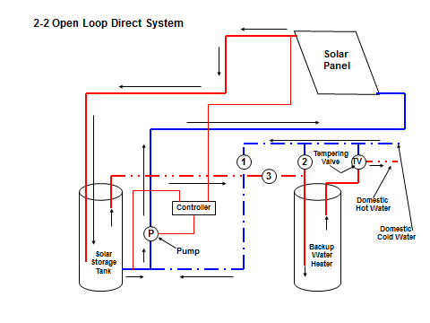
Topic 15 Energy Conservation
Notes:
The presenter should have a copy of the IECC and CT Building Code for this section. Explain IECC residential vs. International Residential Code

Slide 105
2015 IECC C404.4-Insulation of piping
Insulation as per table 403.2.10
  This table gives you the information needed to compute the proper size piping insulation using…
    Actual outside pipe radius.
    Insulation thickness listed in the table for applicable fluid temperature and pipe size.
    Conductivity of alternate material at mean rating temperature indicated for the applicable fluid temperature
    The upper value of conductivity range list in the table for applicable fluid temperature.
Notes:
Table 403.2.10 does not give you the actual insulation sizes but the means to calculate the insulation size.

Slide 106
2015 IECC C404.4-Insulation of piping
Storage water heater and/or heated water storage tank.
  Both the inlet and outlet piping
  Piping to a heat trap or
  The first eight feet, whichever is less.

Slide 107
2015 IECC C404.4-Insulation of piping
Heat traced water piping
  Insulation as per table 403.2.10 or
  As per manufacturers instructions

Slide 108
2015 IECC C404.4-Insulation of piping
Piping insulation shall be continuous.
  Except where passing through framing.
If freezing is an issue, the minimum insulation size as the table shall NOT supersede the required insulation thickness to protect the pipe.

Slide 109
2015 IECC C404.4-Insulation of piping
Exceptions for tube piping insulation.
  The supply tube to the fixture.
  Valves, unions, pumps, and strainers that are 1” or smaller.
  Piping from user controlled shower/tub mixing valves to the water outlet. (e.g. riser off the valve to the shower head)

Slide 110
2015 IECC C404.4-Insulation of piping
Exceptions for tube piping insulation.
  Cold water piping of a demand recirculation system.
  Water tubing from hot water drinking fountain to the outlet.
  Piping at locations where a vertical pipe is installed.
  Piping surrounded by building insulation with an R value of three or greater.

Slide 111

2015 IECC R403.5.3-Hot Water Pipe Insulation (Prescriptive)
R-3 insulation shall apply to the following…
  Piping ¾” or larger.
  Piping supplying more than one dwelling.
  Piping located outside of a conditioned space.
  Piping from the water heater to the distribution manifold.
  Piping located under a floor slab.
  Buried in piping.
  Supply and return piping in recirculation systems other than demand recirculation systems.

Slide 112
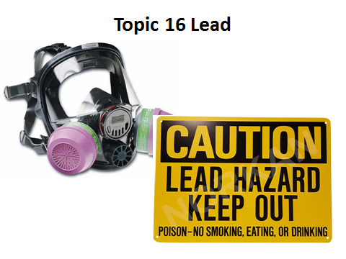
Notes:
The instructor will be allotted 15 minutes for this section. There is a lot of information on lead. The license holder should be aware of the difference between abatement and RRP.

Slide 113
Abatement Vs. RRP
Contractors doing work in older homes need to know the difference between what is classified as a Renovation activity versus a Lead Abatement job, as confusing the two may be very costly to a contractor if they misrepresent the work they are doing for their client. The main difference between Lead Renovation and Lead Abatement work is the intent of the work itself.

Slide 114
Abatement
In the lead-control industry, lead abatement means any set of measures designed to permanently eliminate lead-based paint hazards.
  In response to a child with an elevated blood lead level
  In response to a property with a lead violation imposed upon it
  Or in housing receiving HUD financial assistance.
With Lead Abatement, a government agency is involved from the very beginning, and ultimately, the end result is making a “Lead Free” claim about that home, building or structure, which means that the threat of lead has been removed. Any individual working as an employee on a Lead Abatement job must be certified as a Lead Worker, and work under a Certified Lead Supervisor.

Slide 115
Renovation, Repair & Painting (RRP)
In contrast, Lead Renovation activities are generally defined as any work performed in a pre-1978 residential property where lead-based paint may be disturbed as a result of that work. Again, the intent here is to perform a renovation on the home in question, or routine repair, maintenance or painting work – a renovator’s intent is never to permanently eliminate lead paint hazards or make a “Lead Free” claim about a home, building, or structure – that would be considered a misrepresentation, or fraud. Renovations are performed for many reasons, most having nothing to do with lead-based paint. Renovations involving activities designed to update, maintain, or modify all or part of a building, are covered by the Lead Renovation, Repair, and Painting (RRP) Rule if lead-based paint does in fact show up during pre-renovation lead testing. Activities that are subject to the Lead RRP Rule include:

Slide 116
Renovation, Repair & Painting (RRP)
  Remodeling and repair or maintenance
  Electrical work
  Plumbing
  Painting preparation
  Carpentry
  Window replacement
To be in compliance with the RRP Rule, at least one supervisor on a qualifying job must be trained and certified as a Lead Renovator.

Slide 117
 | RENOVATION (RRP) | LEAD ABATEMENT
Training | 8 hours | 16 hours for Workers, 32 hours for Supervisors
Notification | Not Required | Pre-Abatement Notification Required to EPA or State
Occupants | Distribute the Renovate Right pamphlet | Prepare an Occupant Protection Plan
Clearance | Cleaning Verification (CV) Procedure performed by assigned Renovator | 3rd-Party Dust Clearance performed by a Lead Inspector or Risk Assessor
Reporting | Written report to client detailing test kit results and post-renovation checklist within 30 days of invoice | Lead Abatement Final Report and "Lead Free" Claim
On-Site | Renovator needs to be on site to oversee setting up containment and final cleanup | Supervisor is on site when any work is conducted

Slide 118

Where can I get more information?
https://www.epa.gov/
http://www.ct.gov/DPH/site/default.asp
Notes:
The top address is for the Federal EPA while address #2 is for the CT Department of Public Health

Slide 119

Topic 17 Ladder Safety
Notes:
Falls are the number 1 killer on construction sites and the number 1 cause of fall deaths are ladders. When sitting for an OSHA 10 card, OSHA has mandated that one hour and 15 minutes be set aside for the topic of fall protection.

Slide 120
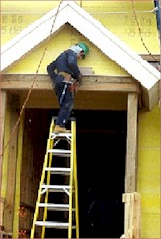
Topic 15 Stairways & Ladder Hazards
Stairways and ladders cause many injuries and fatalities among construction workers
About half the injuries caused by slips, trips and falls from ladders and stairways require time off the job
Improper use of the top rung of a step ladder
Notes:
Reference – OSHA Publication 3124, Stairways and Ladders

Slide 121
Slips, Trips and Falls
On Stairways and Ladders
At the end of this training, you should be able to list or describe:
Safety guidelines and requirements for stairways
used at a construction site
Safe practices and requirements for ladders
used at a construction site

Slide 122
General Ladder Requirements
Ladders must be kept in a safe condition
-- DO –
Keep the area around the top and bottom of a ladder clear
Ensure rungs, cleats, and steps are level and uniformly spaced
Ensure rungs are spaced 10 to 14 inches apart
Keep ladders free from slipping hazards
Notes:
Reference 1926.1053(a) and (b)

Slide 123
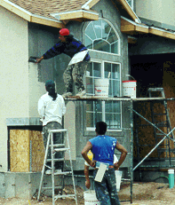
General Ladder Requirements
Use ladders only for their designed purpose
-- DON’T –
Tie ladders together to make longer sections, unless designed for such use
Use single rail ladders
Load ladders beyond the maximum load for which they were built, nor beyond the manufacturer’s rated capacity
Notes:
Reference 1926.1053(a) and (b)

Slide 124
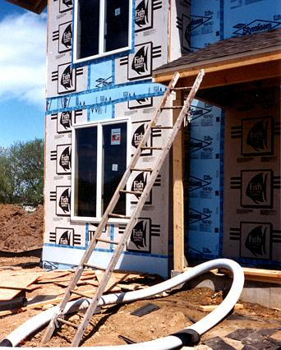
Securing Ladders
This ladder is not on a stable surface
Secure ladders to prevent accidental movement due to workplace activity
Only use ladders on stable and level surfaces, unless secured
Do not use ladders on slippery surfaces unless secured or provided with slip-resistant feet
Notes:
Reference 1926.1053(b)(8), (b)(6), (b)(7), and (b)(1)
Ladders placed in areas such as passage-ways, doorways, or driveways, or where they can be displaced by workplace activities or traffic must be secured to prevent accidental movement, or a barricade must be used to keep traffic or activities away from the ladder.

Slide 125
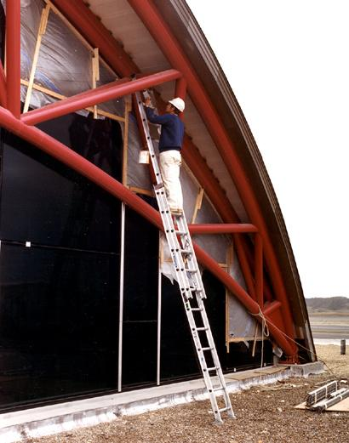
Portable Ladders
Inspect before use for cracks, dents, and missing rungs
Design or treat rungs to minimize slipping
Side rails -- at least 11 1/2 inches apart
Must support 4 times the maximum load
Notes:
Reference 1926.1053(b)(15), (b)(6)(ii) and 1926.1053(a)(4)(ii)
See the OSHA web site at:
www.osha.gov/SLTC/construction_ecat/falls/4ladders.html
Portable Ladder: a ladder that can be readily moved or carried.
Ladder rungs, cleats, and steps must be parallel, level and uniformly spaced.
The rungs and steps of portable metal ladders must be corrugated, knurled, dimpled, coated with skid-resistant material or treated to minimize slipping.

Slide 126
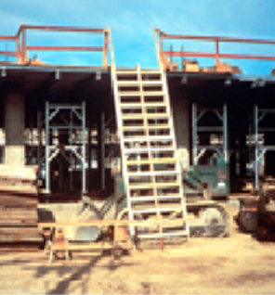
Double - Cleated Ladder
Use a double-cleated ladder ( with center rail) or 2 or more ladders:
when ladders are the only way to enter or exit a working area with 25 or more employees
when a ladder will serve simultaneous two-way traffic
Notes:
Reference 1926.1051(a)(2)
Double-cleat Ladder -
A ladder with a center rail to allow simultaneous two-way traffic for employees ascending or descending.
When there is only one point of access between levels, it must be kept clear to permit free passage by workers. If free passage becomes restricted, a second point of access must be provided and used.

Slide 127
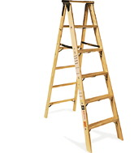
Painting Wood Ladders
Don’t paint ladders
Don’t use an opaque covering (like varnish) on a wood ladder
Notes:
Reference 1926.1053(a)(12)
Wood ladders must not be coated with any opaque covering, except identification or warning labels on one face only of a side rail.

Slide 128
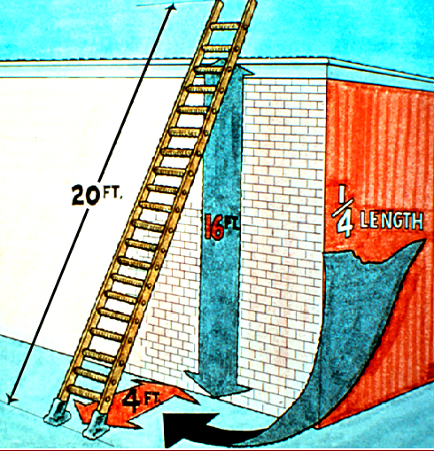
Ladder Angle
Non-self-supporting ladders:
(which lean against a wall or other support)
  Position at an angle where the horizontal distance from the top support to the foot of the ladder is 1/4 the working length of the ladder
Notes:
Reference 1926.1053(b)(5)
Working length of ladder
– Distance along the ladder between the foot and top support

Slide 129
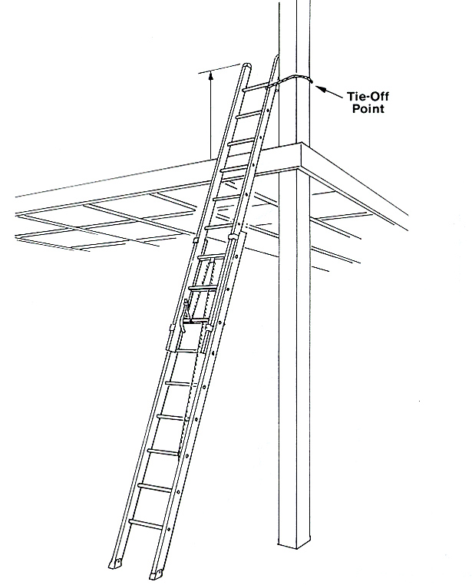
Ladder Rail Extension
When using a portable ladder for access to an upper landing surface, the side rails must extend at least 3 feet above the upper landing surface
Notes:
Reference 1926.1053(b)(1)
When portable ladders are used for access to an upper landing surface, the side rails must extend at least 3 feet above the upper landing surface. When such an extension is not possible, the ladder must be secured, and a grasping device such as a grab rail must be provided to assist workers in mounting and dismounting the ladder. A ladder extension must not deflect under a load that would cause the ladder to slip off its support.

Slide 130
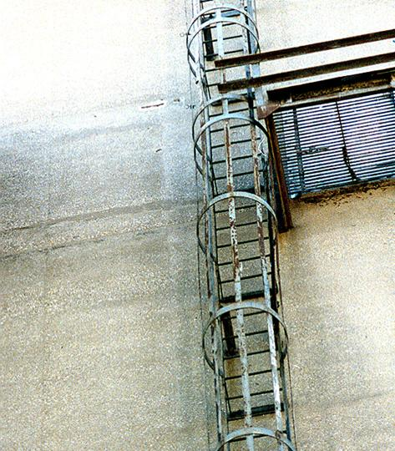
Tall Fixed Ladder Requirements
Equip a fixed ladder 24 feet or longer with either a:
Ladder safety device
Self-retracting lifelines with rest platforms every 150 feet or less
Cage or well, and multiple ladder sections, each section not exceeding 50 feet
Notes:
Reference 1926.1053(a)(18) and (a)(19)
Fixed Ladder: a ladder that cannot be readily moved or carried because it is an integral part of a building or structure.
In using a cage or well, ladder sections must be offset from adjacent sections, and landing platforms must be provided at maximum intervals of 50 feet
Use a fixed ladder at a pitch no greater than 90 degrees horizontal measurement from the back of the ladder.
A fixed ladder must be able to support at least 2 loads of 250 pounds each, concentrated between any two consecutive attachments. It must also support added anticipated loads caused by ice buildup, winds, rigging and impact loads resulting from using ladder safety devices.

Slide 131
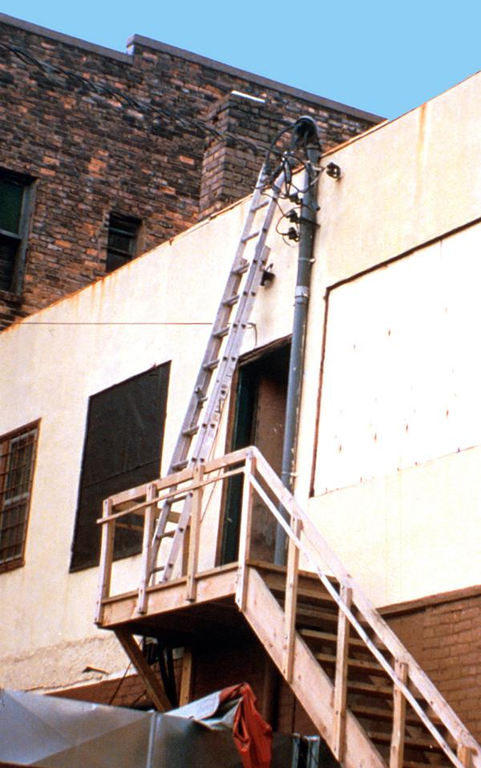
Near Energized Electrical Equipment
If using ladders where the employee or the ladder could contact exposed energized electrical equipment, they must have nonconductive side rails such as wood or fiberglass.
This is an unsafe condition
Notes:
Reference 1926.1053(b)(12)

Slide 132
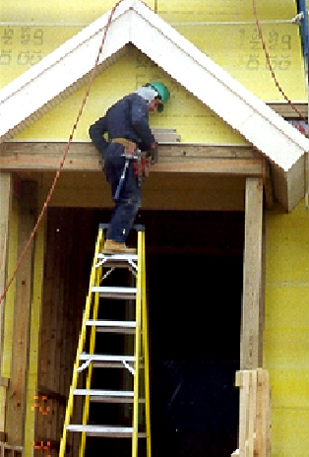
Top Step
Do not use the top or top step of a stepladder as a step
Notes:
Reference 1926.1053(b)(13)

Slide 133
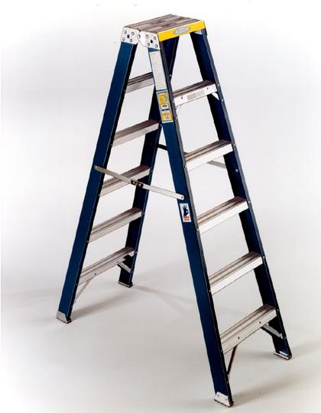
Cross bracing
On this ladder the back rungs
are designed for use
Do not use cross bracing on the rear of a stepladder for climbing - unless the ladder is designed for that purpose.
Notes:
Reference 1926.1053(b)(14)
A metal spreader or locking device must be provided on each stepladder to hold the front and back sections in an open position when the ladder is being used.

Slide 134
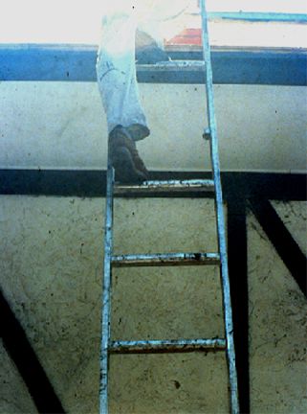
Damaged or Defective Ladders
A competent person must inspect ladders for visible defects, like broken or missing rungs
If a defective ladder is found, immediately mark it defective or tag it "Do Not Use”
Withdraw defective ladders from service until repaired
Missing rung
Notes:
Reference 1926.1053(b)(16)
Ladders must be inspected on a periodic basis and after any incident that could affect their safe use.
Ladder components must be surfaced to prevent injury from punctures or lacerations and prevent snagging of clothing.

Slide 135
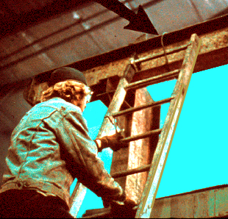
Climbing the Ladder
Face the ladder when going up or down
Use at least one hand to grab the ladder when going up or down
Do not carry any object or load that could cause you to lose balance
Notes:
Reference 1926.1053(b)(20),(21),(22)

Slide 136
Training
A competent person must train each employee in the following areas, as applicable:
The nature of fall hazards in the work area
The correct procedures for erecting,
maintaining, and disassembling the fall
protection systems to be used
The proper construction, use, placement, and care in handling of all stairways and ladders
The maximum intended load-carrying capacities of ladders
Notes:
Reference 1926.1060(a)
Retraining -
Employers must retrain each employee as necessary to maintain the understanding and knowledge acquired through compliance with the standard.

Slide 137
Summary
Key Components for Stairway Safety
Treads
Rails
  handrails
  stair rails
  guardrails
Landings and Platforms

Slide 138

Summary
Key Components for Ladder Safety
A competent person must inspect
Use the correct ladder for the job
Use the correct angle, supports, treads, cross braces and rails
Don’t overload
Your employer must train you in proper use of a ladder

Slide 139

Topic 18 NFPA 99 2015
Health Care Facilities Code
Notes:
We have included notes on many of the slides for the instructor. A suggestion for those doing presentation would be to keep this view while presenting so the instructor will have access to the notes but to project only the presentation view to the students. Instructors must have a copy of either NFPA 99 2015 edition or a copy of the 2012-2015 changes to NFPA 99. A copy can be printed by going to the link below or by typing “changes between the 2012 and 2015 nfpa 99 code” into a google search.
http://www.mgpho.org/Resources/Documents/Library%20Articles/Changes%20in%20Medical%20Gas%20and%20Vacuum%20Systems%20by%20Mark%20Allen.pdf

Slide 140
Discussion Topics
Why a state medical gas certification
Public Act 02-9
N.F.P.A. 99
  Changes between the 2015 and 2012 codes can be found by going on-line to….
    http://www.mgpho.org/Resources/Documents/Library%20Articles/Changes%20in%20Medical%20Gas%20and%20Vacuum%20Systems%20by%20Mark%20Allen.pdf
Notes:
Presenters must have a copy of the changes or a copy of 2015 NFPA 99.

Slide 141
Why A State Medical Gas Certification
There have been many documented cases of medical gas related deaths.
Some are due to installation methods.
Some are due to improper testing.
But all could be avoid if the standard is followed and enforced.

Slide 142
Some Cases in Point
Dayton, Ohio
  Oxygen System Mix-Up Suspected In Nursing Home Deaths
    2 death, 8 others hospitalized
Allen, Texas
  Parents Get $4.7 Million
    14 month old baby’s death due to cross connection
Temple, Texas
  Mystery Tangles Hospital Death
    6 death, 70 others under observation

Slide 143
Public Act 02-92
An Act Ensuring the Proper Installation and Maintenance of Medical Gas and Vacuum Systems
Approved June 3, 2002
Effective July 1, 2003

Slide 144
Sec. 2. Section 20-334a
General Statutes
Amended by adding subsection (g) as follows
(New) (g) On or after July 1, 2003, a medical gas and vacuum systems certificate for medical gas and vacuum systems work may be issued by the department, upon the authorization of the Plumbing and Piping Work Board or the Heating, Piping and Cooling Work Board, as appropriate to any person who…
Notes:
These next three slides are the section of the General Statute requiring persons working on medical gas systems to have both a third party medical gas certification and a State of CT certification. The presenter may want to skim these pages and not read them in their entirety. The presenter should bring up the fact that this bill was passed unopposed.

Slide 145
Sec. 2. Section 20-334a
(1) has been issued a P-1, P-2, S-1, S-2, S-3 or S-4 license under subdivision (1) of subsection (a) of this section, (2) has been certified as a medical gas and vacuum system brazer issued in accordance with the standards of Section IX entitled “Welding and Brazing Qualifications” of the American Society of Mechanical Engineers Boiler and Pressure Vessel Code, and
Notes:
Which license holders can obtain an MG 1 or 2

Slide 146
Sec. 2. Section 20-334a
(3) Has been certified as having completed an approved training course on medical gas and vacuum system installation as required by American National Standards Institute-American Society of Sanitary Engineering Series 6000. No person shall perform medical gas and vacuum systems work unless such person has obtained a certificate pursuant to this subsection. Such certificate shall be renewed consistent with the renewal process for the prerequisite licenses. The fee for such certificate shall be twenty-five dollars.

Slide 147
N.F.P.A. 99 Scope
Chapter 1 Administration
Chapter 2 Referenced Publications
Chapter 3 Definitions
  Scope
    Establishes Minimum criteria
    Chapter 4 establishes criteria for the levels of health care services or systems bashed on risk to the patients, staff, or visitors in health care facilities.
Notes:
Presenters may want to state that NFPA 99 is comprised of 15 chapters but for the purposes of this presentation we will be mostly concentrating on chapter 1, 4 and 5. We will actually be starting with chapter 4 which defines what the rick categories are as well as list some examples in the notes section of the slide.

Slide 148
What is a health care facility?
For the purposes of this code, a health care facility is defined as: Buildings, portions of buildings, or mobile enclosures in which human medical, dental, psychiatric, nursing, obstetrical, or surgical care is provided. 3.3.67
In 2017 section 1.3.1 was added.
  Veterinary has been added to the excluded facility types.

Slide 149
Chapter 4 Fundamentals
Risk Categories
  Risk Categories are assigned as either Category 1, 2, 3 or 4, depending on risk to the patient, staff or a visitor to the health care facility.
  Previous NFPA codes referred to Risk Categories as either…
    Type
    Level or
    Category

Slide 150
Category 1
Where a failure of equipment, systems and or activities are likely to cause major injury or death of patients, staff, or visitors shall be designed to meet the requirements of Category 1, as stated in this code.
  Category 1 is covered in Chapter 5 Gas and Vacuum Systems Section 5.1 Category 1 Piped Gas and Vacuum Systems through
  Section 5.1.14 Category 1 Operations and Management
Notes:
Examples are an Operating Room, ICU

Slide 151
Category 2
Where a failure of equipment, systems and or activities are likely to cause minor injury or death of patients, staff, or visitors shall be designed to meet the requirements of Category 2, as stated in this code.
  Category 2 is covered in Chapter 5 Gas and Vacuum Systems Section 5.2 Category 2 Piped Gas and Vacuum Systems through
  Section 5.2.14 Category 1 Operations and Management
    Many of the sections in Category 2 will refer you back to the corresponding section of Category 1
Notes:
Patient room

Slide 152
Category 3
Where a failure of equipment, systems and or activities are not likely to cause minor injury or death of patients, staff, or visitors but may cause discomfort, shall be designed to meet the requirements of Category 3, as stated in this code.
  Category 3 is covered in Chapter 5 Gas and Vacuum Systems Section 5.3 Category 3 Piped Gas and Vacuum Systems through
  Section 5.3.14 Category 1 Operations and Management
    Unlike Category 2, Category 3 has many differences from Category 1. Although there are sections in Category 3 that reference Category 1.
Notes:
Dental office

Slide 153
Category 4
Activities, systems or equipment whose failure would have no impact on patient care shall be designed to meet Category 4 requirements, as detailed in this code.
Where a failure of equipment, systems and or activities has no affect on patients, staff, or visitors shall be designed to meet the requirements of Category 4, as stated in this code.
Notes:
Storage room

Slide 154
Qualifications of Installers
Shall be certified in accordance with ASSE 6010
  ASSE 6010 requires…
    Pass a 100 question closed book test on NFPA 99
      This test must be renewed with the updating of the code.
    Pass a 1.5” copper braze test two couplings one in the horizontal position and one in the vertical position using up flows only.
      The braze certification has to be maintained every six months by submitting a brazer continuity form on company letterhead to the original certifying agency.
Notes:
It should be noted that when ever a journeyperson or contractor renews this certification that they are swearing that their certifications are current and up to date. The plumbing board does ask for audits to see if certifications are current. Lying may cost you to lose the certification and fines. Remember your braze certification must be renewed every six months and your installer certification (written test) must be renewed every three years. The installer certification in normally a 40 question open book test.

Slide 155
Qualifications of Installers
Installers of medical gas systems shall NOT use their certification to oversee installation by non-certified installers.
Prior to any installation work, the installer of medical gas and vacuum piping shall provide and maintain documentation on the job site for the qualification of brazing procedures and individual brazers.
Notes:
Just as a plumbing license does not allow some who is either not licensed or a registered apprentice work under a license. The same holds true with medical gas certification's. You MUST have a current medical gas brazer/installer certification as well as a current P-1, P-2, S-1, S-2, S-3 or S-4 state occupational license.

Slide 156
Maintaining Certifications
Medical Gas Brazing certifications are required to be maintained every six months. A letter of brazer continuity must be sent to the issuer of the braze certification to maintain continuity.
The medical gas install portion of the certification must be maintained every three years. This can be accomplished by taking a 40 question open book test.
The State of CT Medical Gas certification is not valid without and up-to-date certification card and the certification card is not valid without a State of CT certification
Notes:
Presenters should impress on the students that the MGV is NOT a license but only a certification. As stated in the slide, if a person holds a current State of CT certification but their brazer and installer certification is not also current, the state certification is invalid. The same holds true if the brazer and installer certification is current but the state certification is not current the certification is invalid. Both certifications MUST be current for persons to legally install medical gas system.

Slide 157

Qualification of Brazing Procedures
Company’s must have an approved written brazing procedure that comply’ with Section IX of the Welding and Brazing Qualification of the ASME Boiler and Pressure Vessel Code, or AWS B2.2 Standard for Brazing Procedure and Performance Qualification.
The installing company has to qualify one brazer following each brazing procedure specification used.
These records should be part of turnover documentation as well as all brazer qualification records to the end user.
Notes:
In medical gas system installations, we are dealing with life and death situations. A paper trail must be maintained in case of any type of mishap that may occur.

Slide 158

The End—Your Feed Back
Notes:
Suggestions on topics students may like to see discussed.

